Slide 1
IPC Escape Room
Hidden Risk
Press F5 to Begin Slide show, then click on the blue button in the bottom right!
Click Here to Continue

Slide 2
Disclaimer*
This escape room game is intended for infection prevention and control educational purposes only and is not intended to depict the actual practices of laboratory services personnel.
This escape room is expected to take about 20 minutes, though you can quit at any time. If it takes you longer however, don’t worry about it! Sometimes it is easy to miss something!
Click Here to Continue

Slide 3
Instructions
Welcome to the first Virtual IPC escape room! Before we begin lets discuss some rules:
You will only need the mouse and left click button to complete this escape room
DO NOT use the keyboard or “Right Click” as this can break the game
If there is dialogue on the screen, you may need to click to progress.
If you need to take a break you can press “ESC” on your keyboard, then make note of what slide is highlighted. When you want to continue, select the slide you ended at and hold down the shift key,
then press the F5 key
Click Here to Continue

Slide 4
Tips
Click Here to Continue
Where you click matters, and some objects can be interacted with by clicking on them
Generally, clicking on specific objects requires the dialogue box be closed
There is no guessing required in this game, so look around for clues as to what the answers or codes might be
No outside knowledge is required, you do not need to search outside of this PowerPoint for an answer, if there is information you need to know, it can be found within the escape room
If you get stuck, try asking for help sometimes a fresh pair of eyes is all you need!

Slide 5
That’s it!
You now know everything you will need to play through this virtual escape room
As an option, consider setting a timer to see how long it takes you!
When you’re ready, press play!
PLAY

Slide 6
3

Slide 7
2

Slide 8
1

Slide 9
Click to continue
BZZ BZZ
Hey, I got a text….

Slide 10
Click to respond
It’s my friend Fauna… wonder what’s up with them?

Slide 11
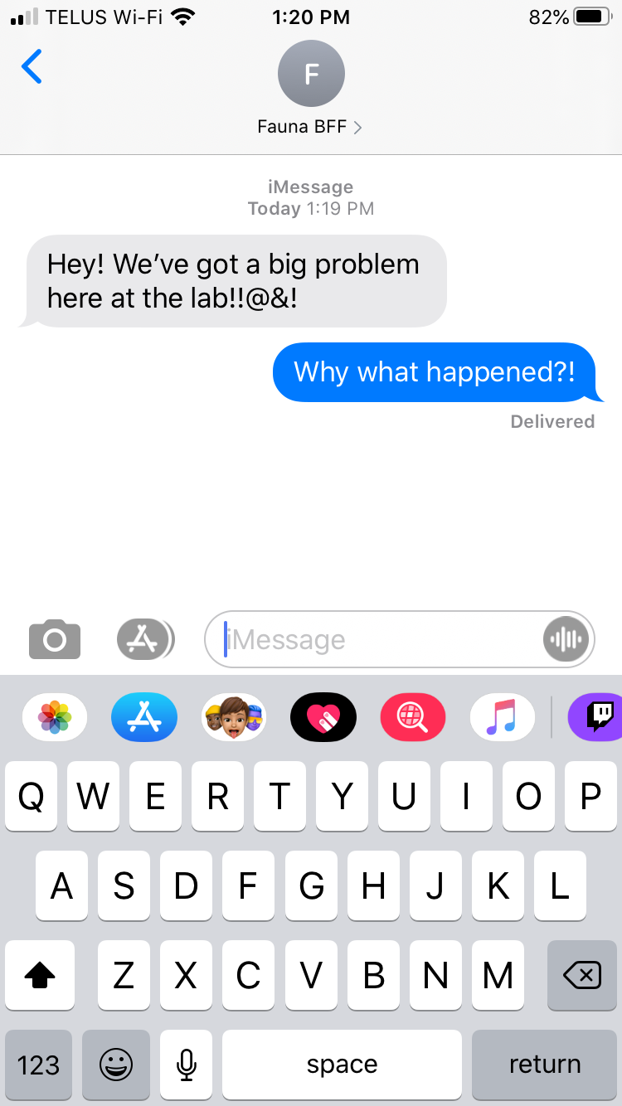

Slide 12
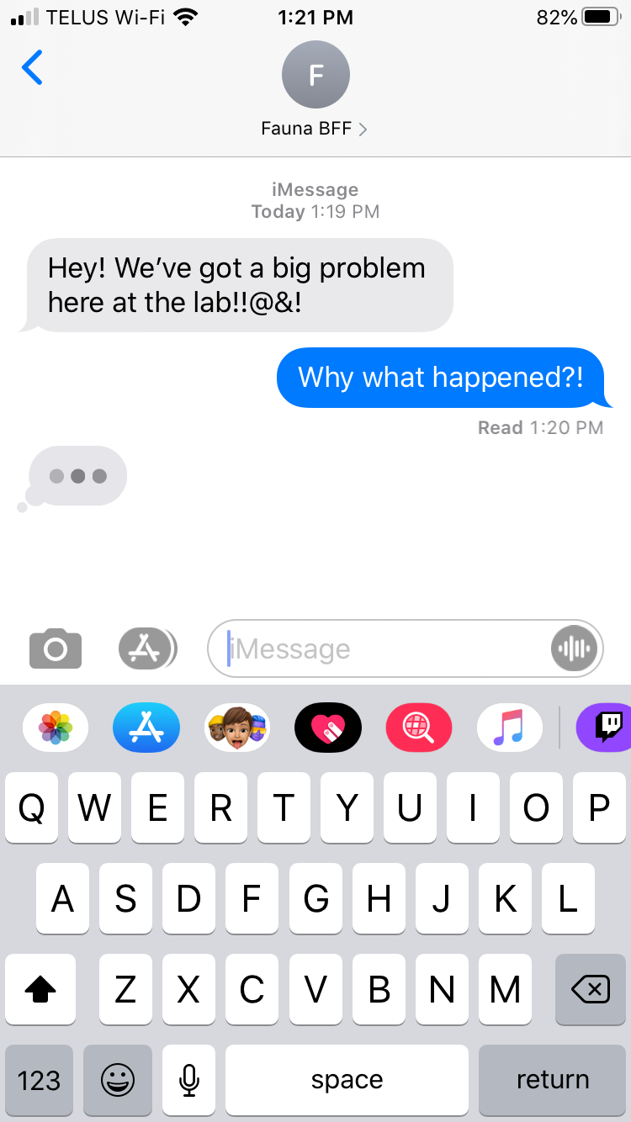

Slide 13
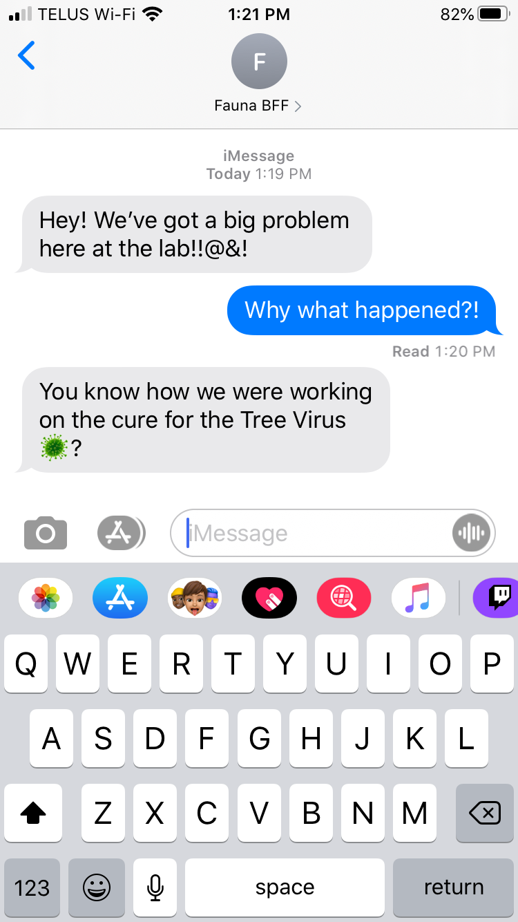
Click to respond

Slide 14
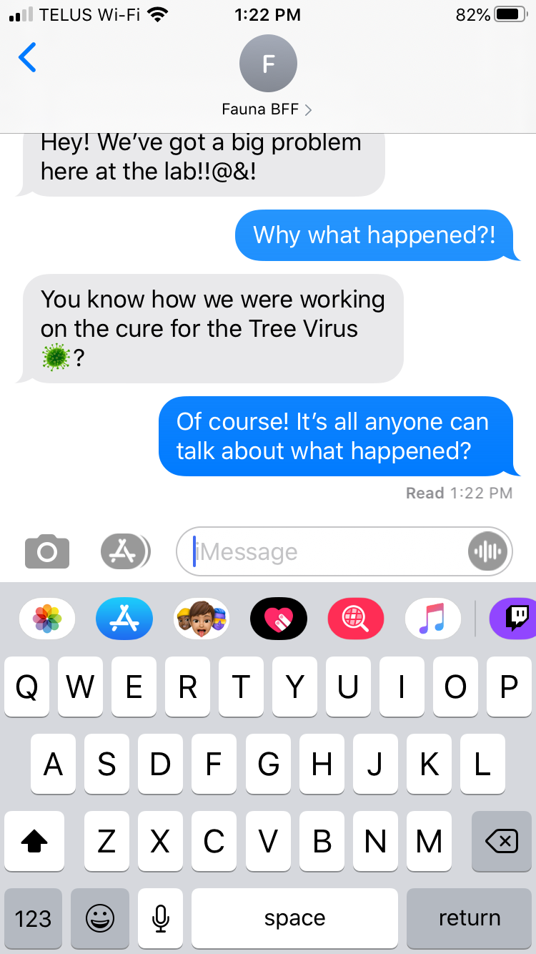
Click to continue
About one week ago a virus broke out in our area that has been turning people into immobile trees in under an hour. It’s been pretty crazy! Fauna was one of the few scientists hand picked to be on the research team looking for a cure.

Slide 15
Click to continue
Medical professionals say those turned into trees are still alive, and in theory if they could be cured they would be able to return to normal, so a lot of hope has been placed on Fauna’s research team.

Slide 16
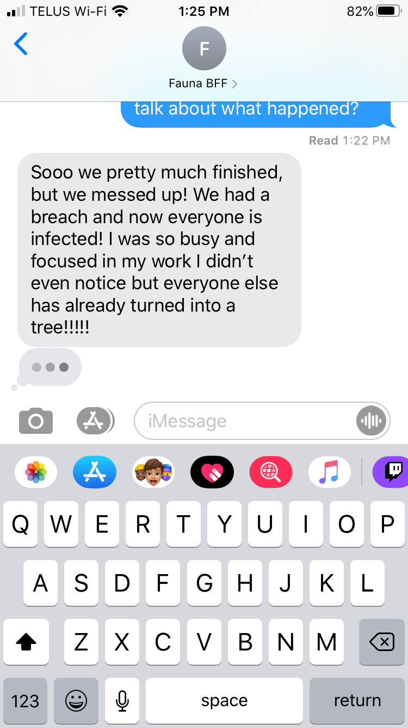
Click to continue

Slide 17
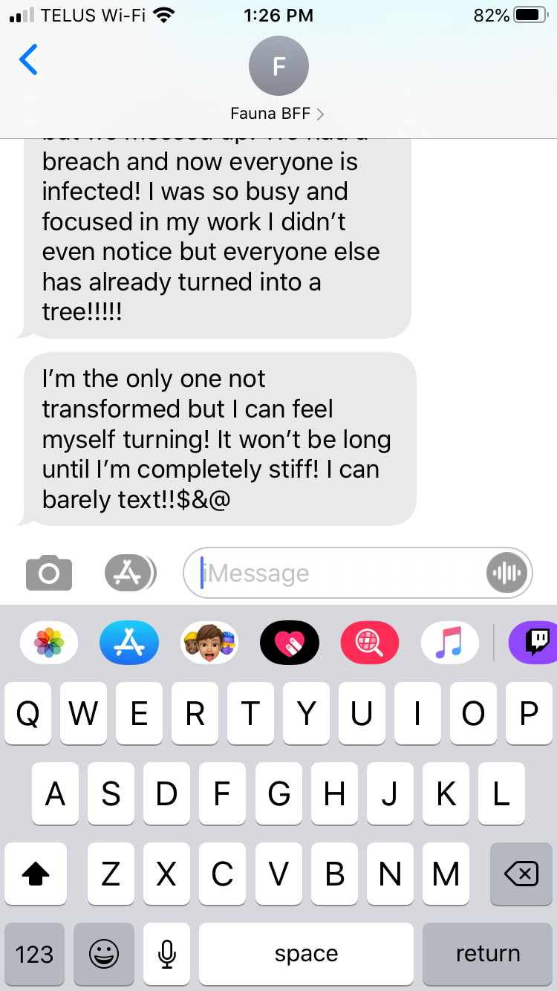
Click to continue

Slide 18
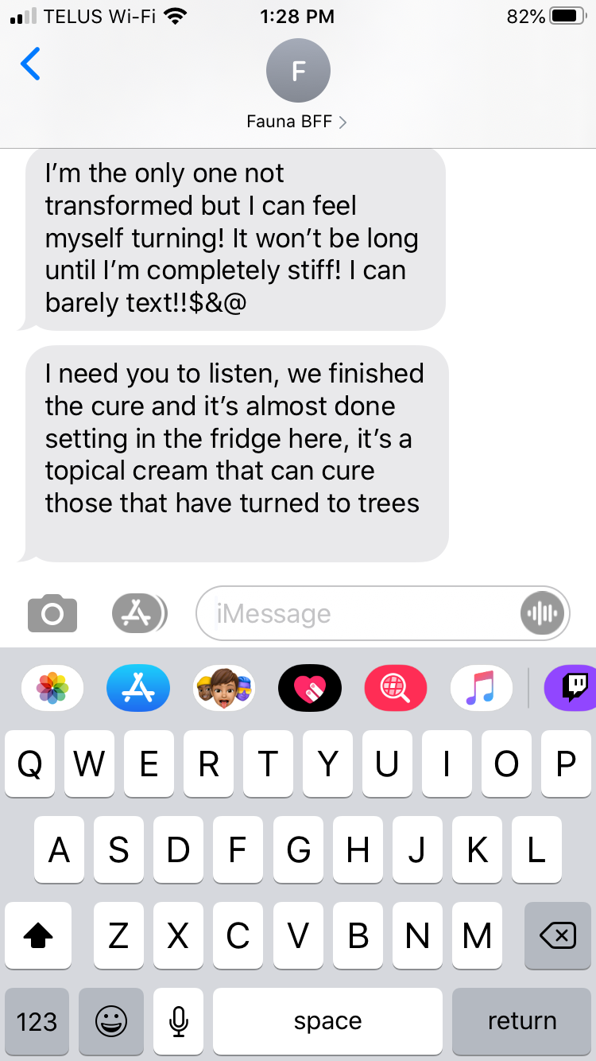
Click to continue

Slide 19
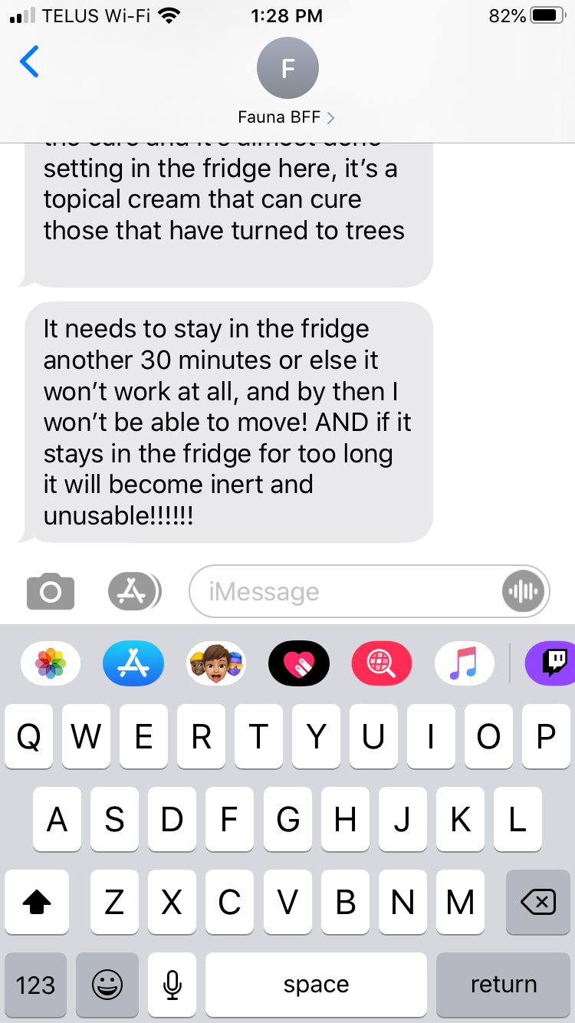
Click to continue

Slide 20
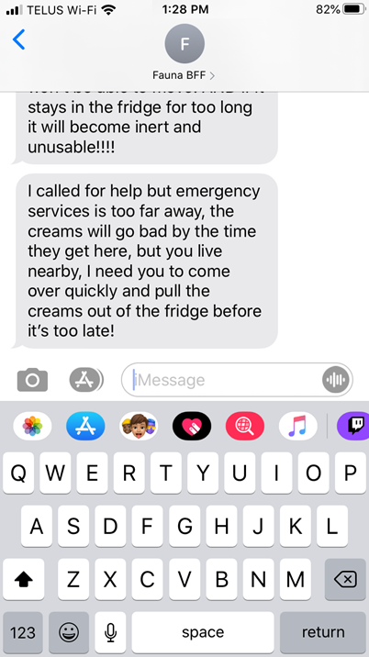
Click to continue

Slide 21
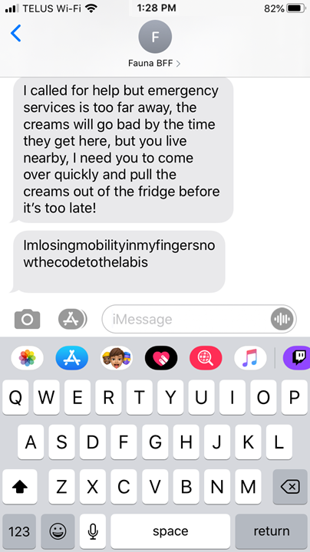
Click to respond
That last text is hard to read, is Fauna struggling to type? You think it says “I’m losing mobility in my fingers now the code to the lab is”

Slide 22
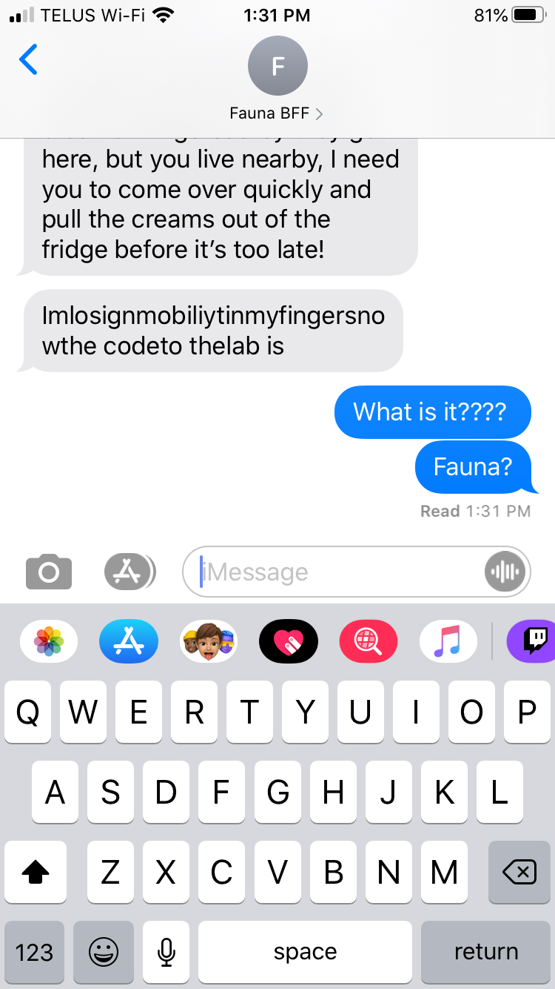
Click to continue
Fauna didn’t respond after that, maybe she is completely immobile now..

Slide 23
Click to continue
You live close to the lab which is why Fauna contacted you. You quickly head out the door and rush over to the lab as fast as you can.

Slide 24
Outdoor lab intro
After a short travel you arrive at the laboratory where Fauna works. There are a few cars in the parking lot but not a person to be seen.
The front door opens easily so you stroll inside.

Slide 25
Outdoor Greater text
After you enter the front doors you are greeted by another set of doors.
Uh oh. They’re locked. You shout out “Hello!” and give the door a hard knock, but nobody answers.

Slide 26
Outdoor Greater text 2
You notice on the wall beside the door, is a small keypad - it looks like the door needs a code to be opened.
Why didn’t Fauna tell you the passcode?! You suppose she didn’t think of it, to be fair she was probably panicking since she is likely a tree by now…
You try kicking down the door, but it’s incredibly sturdy.

Slide 27
Outdoor Greater text 2
Think, think, think!
Wait, you remember Fauna telling you that the laboratory changes the passcode every week and to get in they need to solve this week’s puzzle (Or have a colleague help you out). Let’s try looking around for clues, maybe you can figure it out, if Fauna can do it, you can!
(When this dialogue box disappears try clicking on objects in the room!)

Slide 28
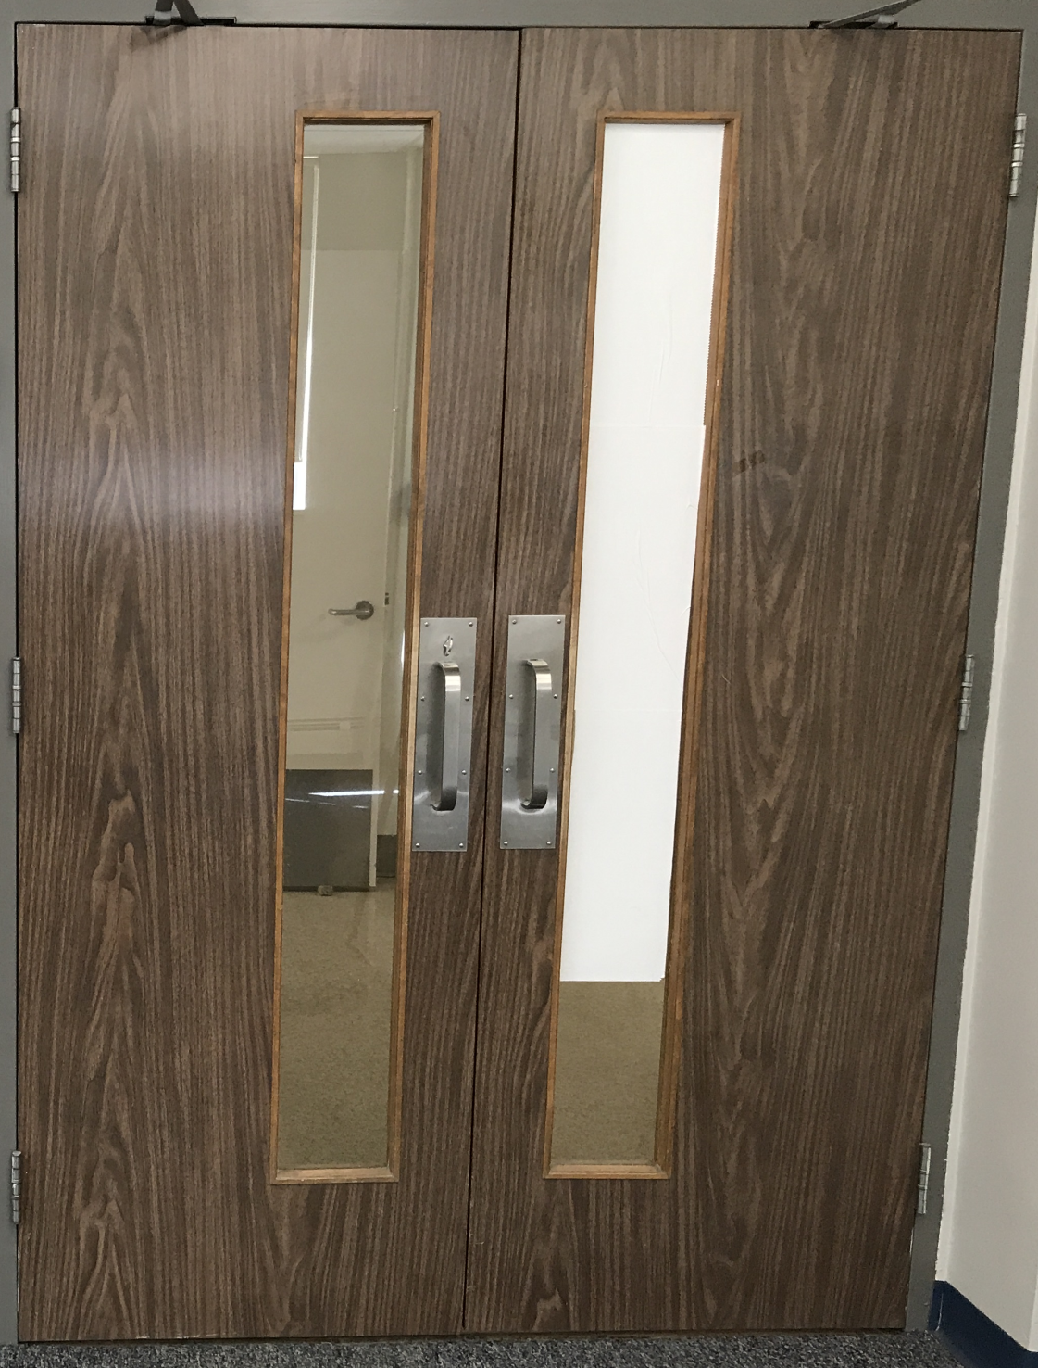
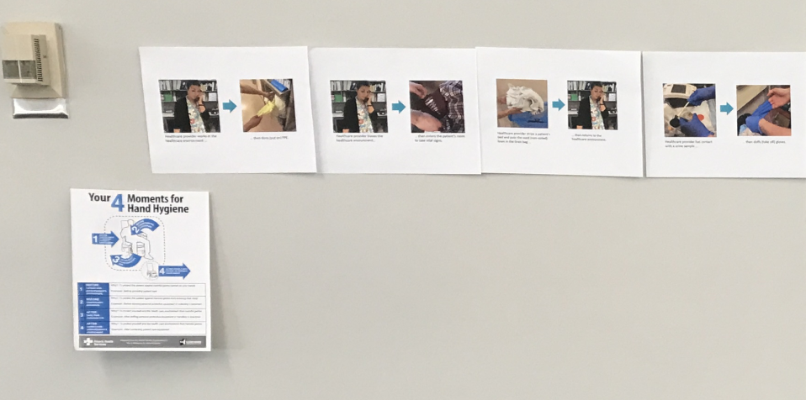
Outdoor Greater clickable

Slide 29
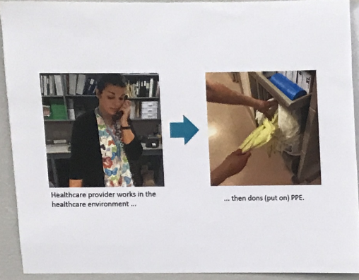
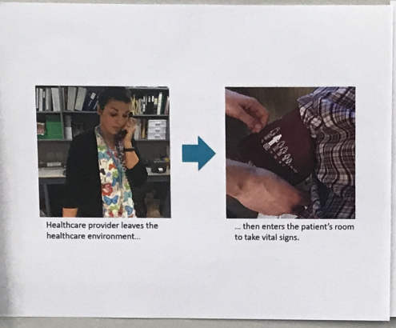
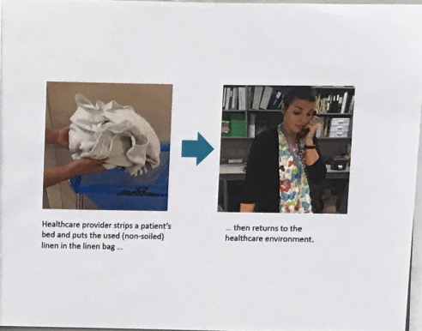
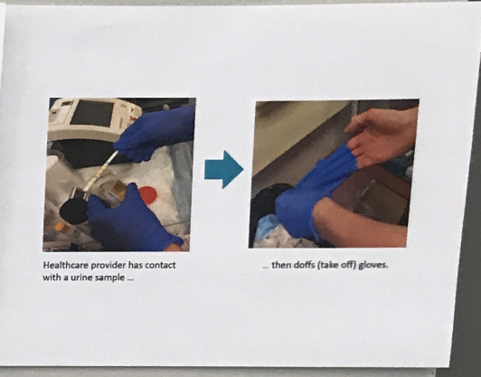
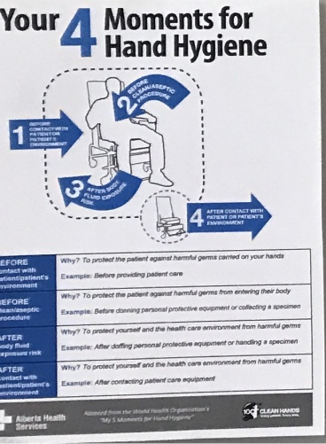
Poster zoom Intro
Looking closer at the wall there are 4 posters in a row, and one more below it to the left.
(Clicking on some objects allows you to take a closer look and can sometimes give hints!)
Note: Sometimes when a dialogue box is open (Like this one) you will not be able to select an object until the dialogue box is gone. Click anywhere to remove this dialogue box, then try clicking on one of the posters.

Slide 30
Poster zoom clickable
Back to Doors

Slide 31
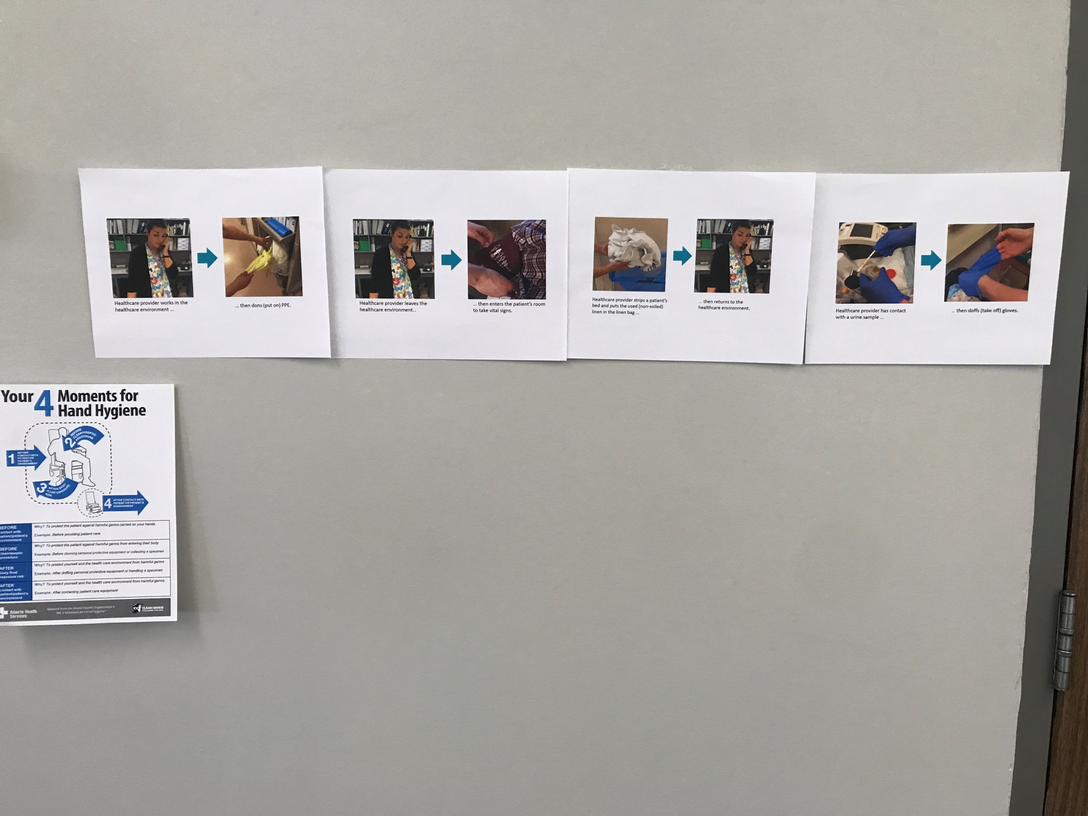
4 Moment poster
“Your 4 Moments for Hand Hygiene”
Hmmm is this poster trying to tell me when to clean my hands?

Slide 32
Back to Posters

Slide 33
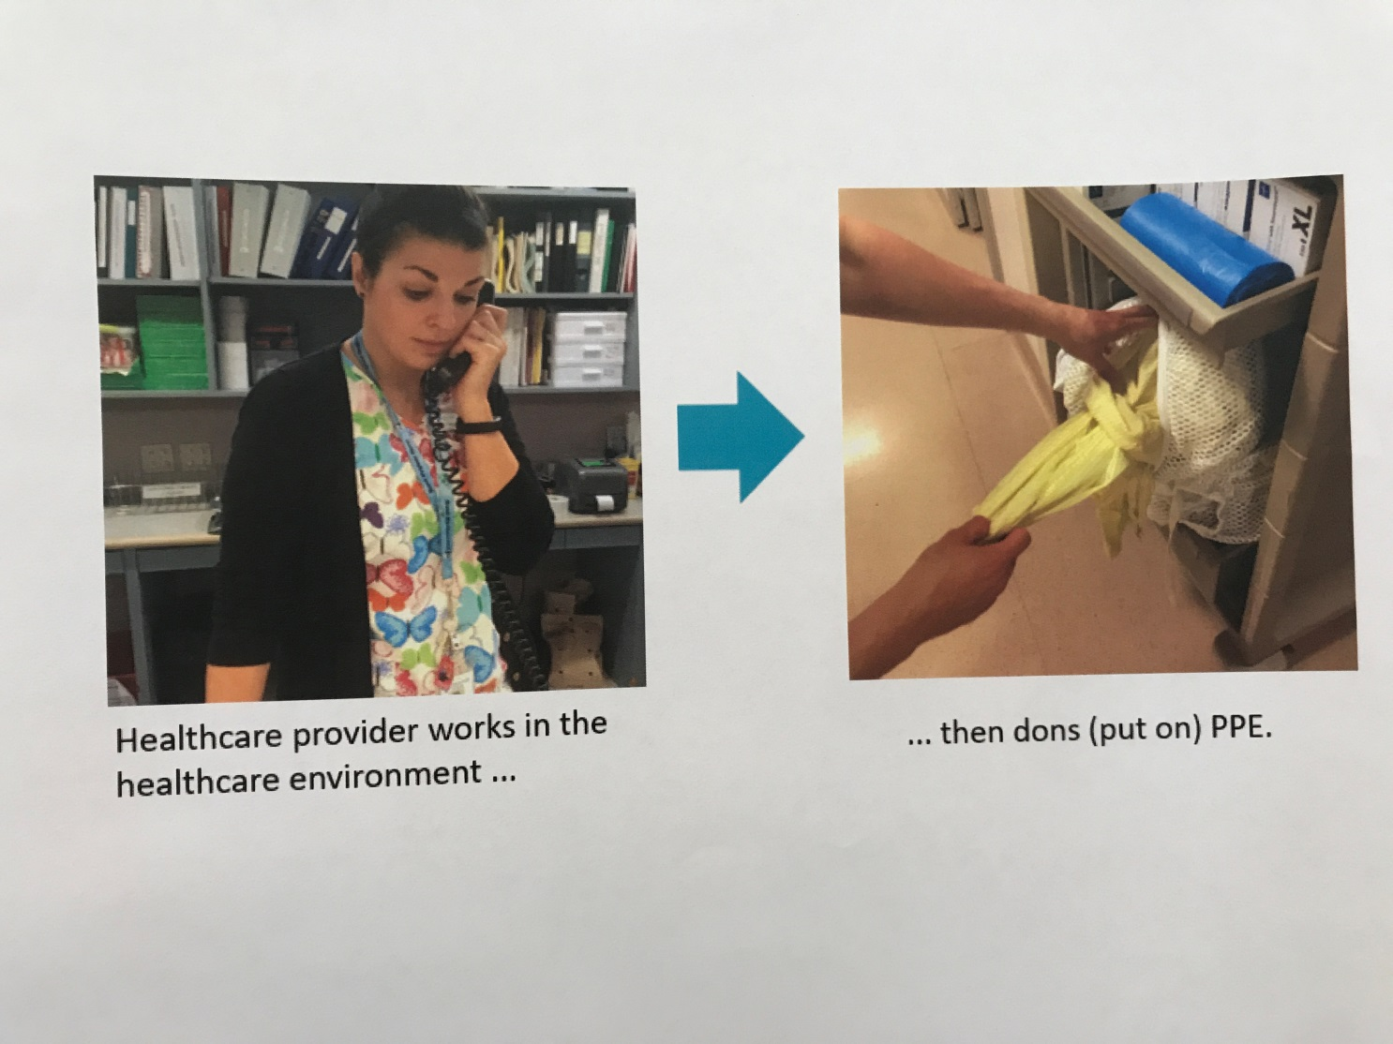
First poster
It looks like these posters in the top row are each describing a different situation.
In this one it has a healthcare provider answering a phone, and then she puts on clean PPE (I think PPE is ‘Personal Protective Equipment’).

Slide 34
Back to Posters

Slide 35
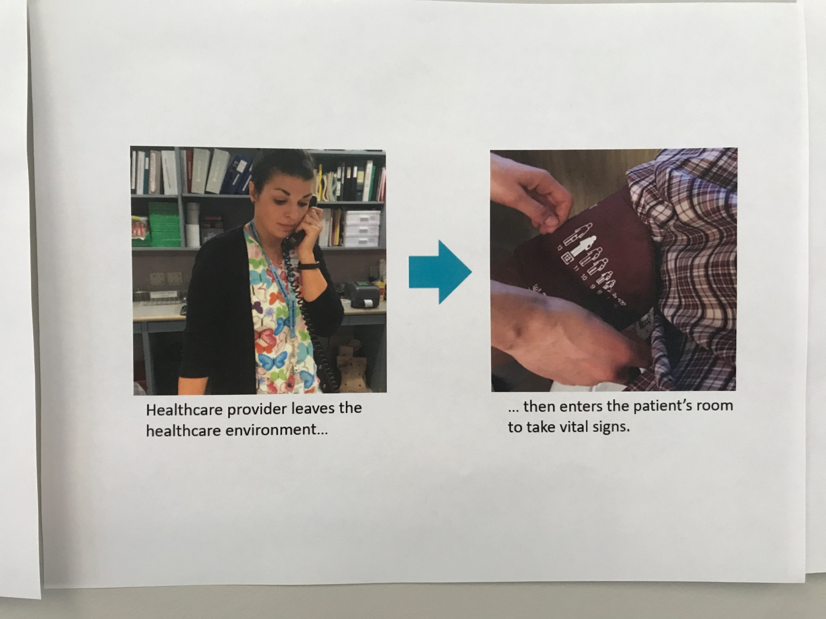
Second POster
This is the second poster in the top row.
It has a healthcare provider on the telephone, and then they are putting a blood pressure cuff on a patient to take their vital signs.
I wonder how the top row relates to each other?

Slide 36
Back to Posters

Slide 37
Third POster
This is the third poster in the row. It looks like the healthcare provider was contacting a patient’s bed linens, dropped them in a soiled linen bag, and then went to talk on the telephone.

Slide 38
Back to Posters

Slide 39
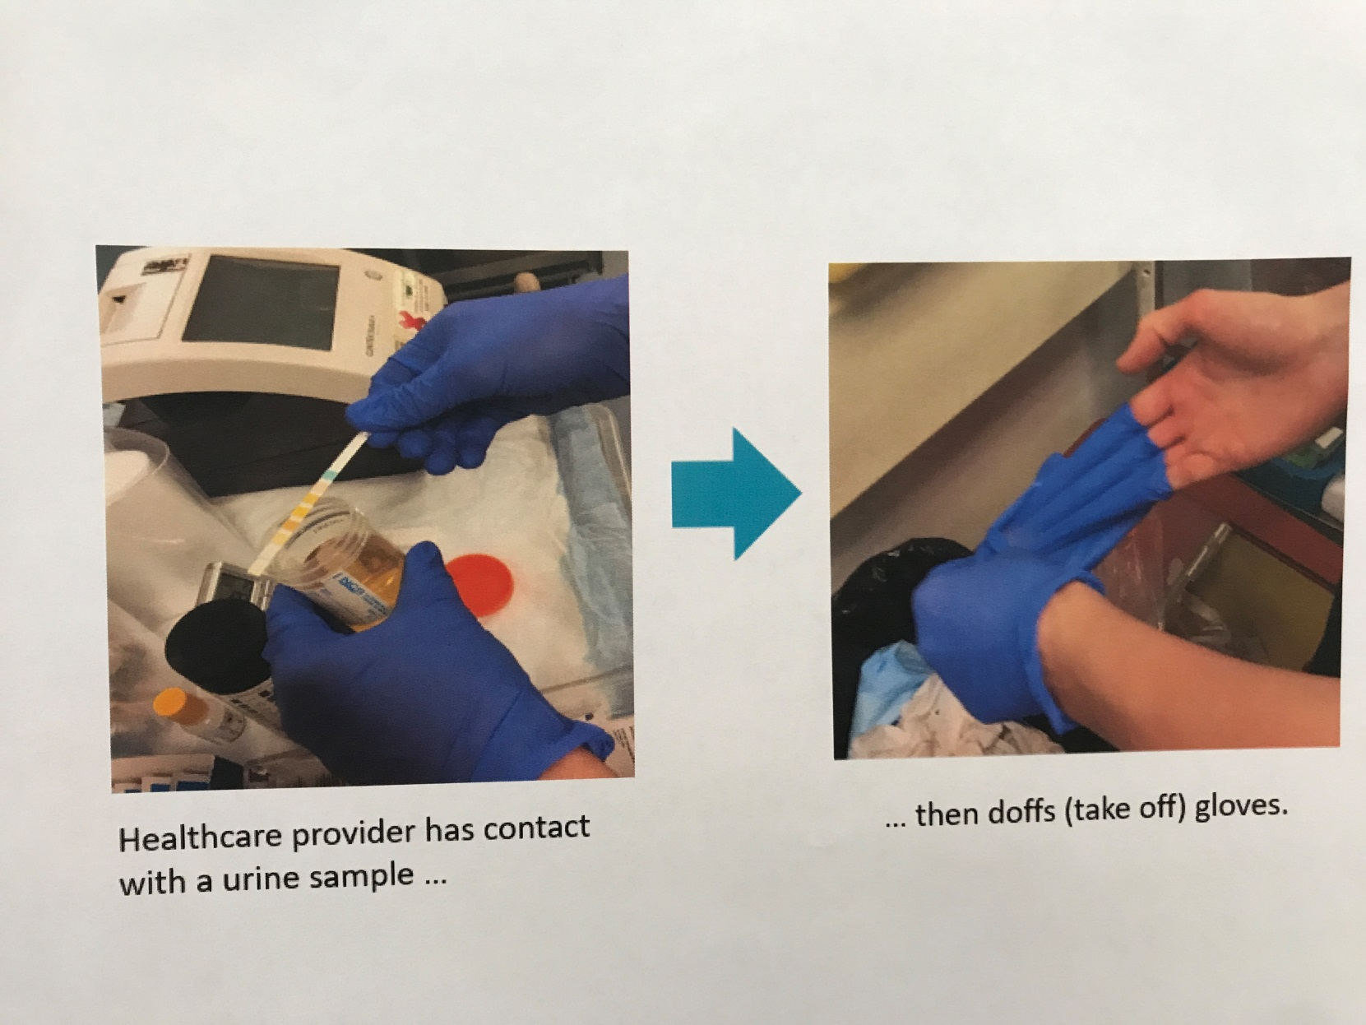
Fourth Poster
This is the fourth and last poster in the row…
In this one a healthcare provider has contact with a urine sample (Gross! But at least they have gloves on…)
Then they take off their gloves and put them in the trash.

Slide 40
I would probably clean my hands after if I was
handling urine, even with gloves on……. Wait, is cleaning your hands how these are connected?

Slide 41
Back to Posters

Slide 42
Hmm….. how do each of these pictures connect with the 4 moments of hand hygiene? Are each of these supposed to represent a time a healthcare worker is supposed to clean their hands? How do I get a code out of that…

Slide 43
Door text
You try the door, giving it a hard push and pull. Unfortunately it is still locked, however while doing so you notice a small black keypad to the left of the door, maybe this is how I can unlock the door?

Slide 44
Keypad Intro
There’s a small keypad here with 4 numbers, Fauna didn’t make this easy by giving me the code did she?

Slide 45
Keypad Intro 2
Wait, I remember Fauna saying she always had to solve a puzzle for that week’s code, and they always change it. Then she talked about some Ravenclaw thing… Whatever that means…
I’m sure something nearby will be a clue…

Slide 46
Keypad Intro 3
You play around a bit with the buttons and discover that each number can be used only once, and that you need a 4 digit code.

Slide 47
Keypad CLICK TO BEGIN CODE
Go Back
CLICK TO BEGIN CODE

Slide 48
Keypad clickable nothing pressed
Go Back
Press the first digit now.

Slide 49
Incorrect Path FIRST
Go Back
Press the second digit now.

Slide 50
Incorrect Path Second
Go Back
Press the third digit now.

Slide 51
Incorrect Path THIRD
Go Back
Press the fourth digit now.

Slide 52
Incorrect Path FOURTH
You press the fourth digit of the code.

Slide 53
Incorrect Path FAIL MESSAGE
Go to Posters
Try Again
The keypad lights up red and gives a little BZZT.
You try the door but it is still locked, it looks like that was not the right code…

Slide 54
Incorrect Path FAIL MESSAGE HINT
Go to Posters
Try Again
You won’t need to guess the code or anything else in this escape room. Have you tried looking at the posters? What moment is each poster trying to convey?
Press “Try Again” to try entering another code or “Go to Posters” to take another look at the posters on the wall.

Slide 55
Correct Path Pressed 2 FIRST
Go Back
Press the second digit now.

Slide 56
Correct Path Pressed 1 SECOND
Go Back
Press the third digit now.

Slide 57
Correct Path Pressed 4 THIRD
Go Back
Press the fourth digit now, only one more number needed.

Slide 58
Correct Path Pressed 3 FOURTH
You press the last digit of the code: 2143
You hear a single BEEP and then a noise come from the door, did it just unlock?

Slide 59
Scene 1 Success FINAL
You give the handle a pull. SUCCESS!! It opens smoothly and leads down a short hallway.

Slide 60
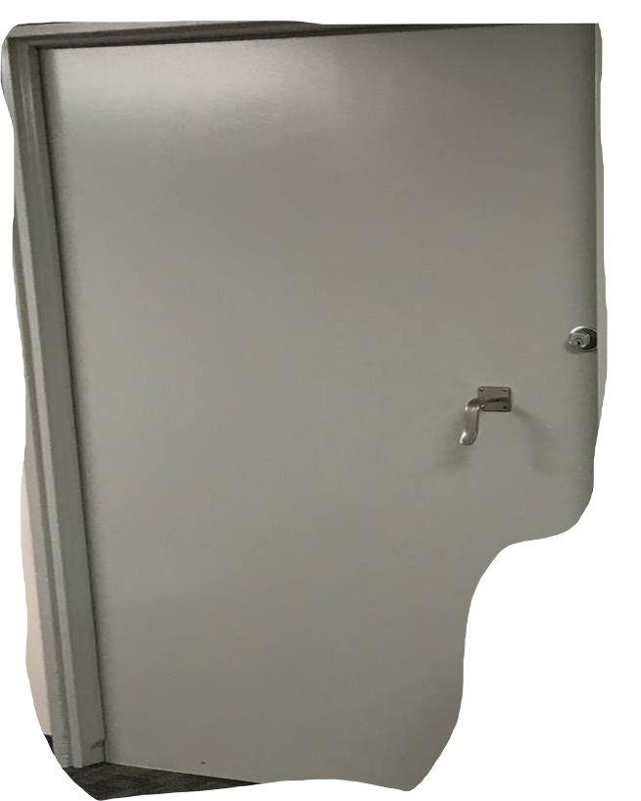
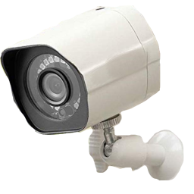
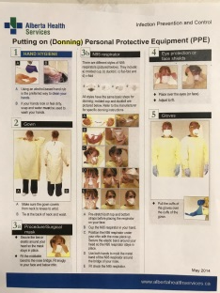
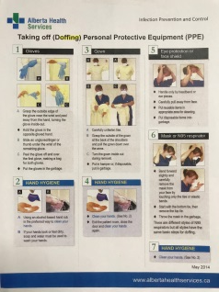
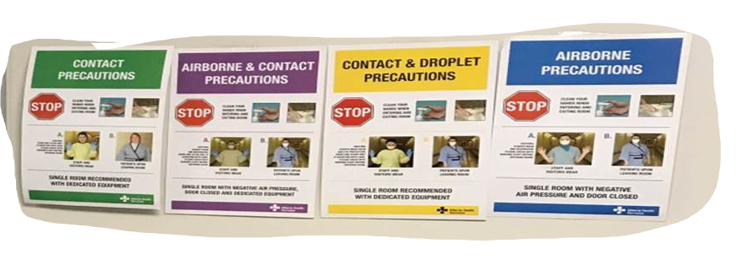
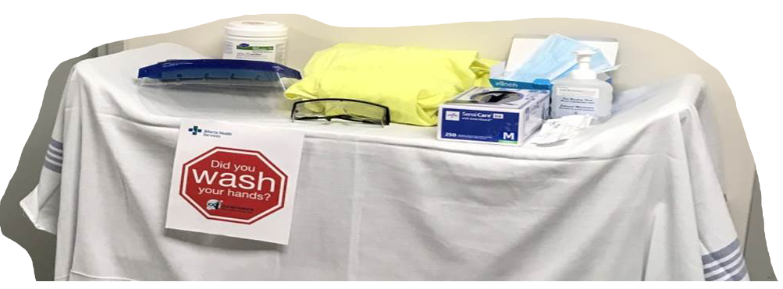
Scene 2 Intro
At the end of the short hallway you reach a small area and.. Another door! You take a quick look around - there’s a weird cart with some stuff on it, some posters, and off to the side there is a desk with a computer.
You try the door hopefully but, drat it too is locked, nothing comes easy here does it?
Go to Desk

Slide 61
Scene 2 Intro 2
Go to Desk
As you try the door handle you hear a loud“BEEP”. It sounds like the noise came from the camera that is pointing at you attached on the right side of the door.

Slide 62
Scene 2 Intro 2
“Incorrect PPE detected. Please use proper donning procedures to don appropriate PPE for current lab setting. See IPC resource manual “Lignum Virum”for more information.”
Go to Desk

Slide 63
Scene 2 Intro 2
The camera finishes lecturing you and goes silent. You try the door again, still locked. Guess you will have to follow the camera’s request…

Slide 64
Scene 2 Greater Door Clickable
Go to Desk

Slide 65
Scene 2 PPE CART PRE COMPUTER
You take a closer look at the cart in front of you. It appears to have various pieces of personal protective equipment. But which do you need? You should probably figure out what I need to wear before I start playing dress-up.
Go to Desk

Slide 66
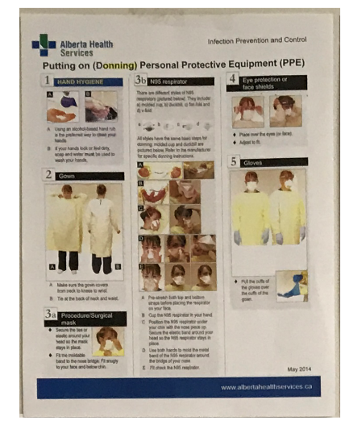
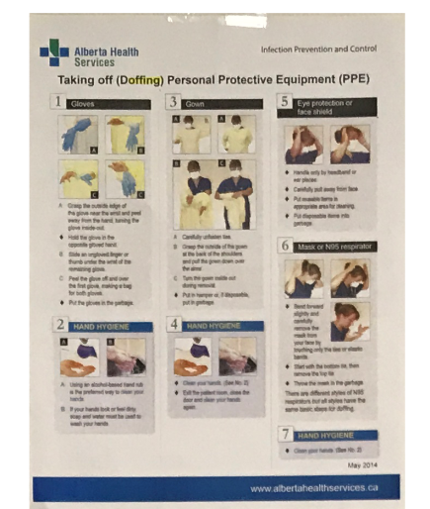
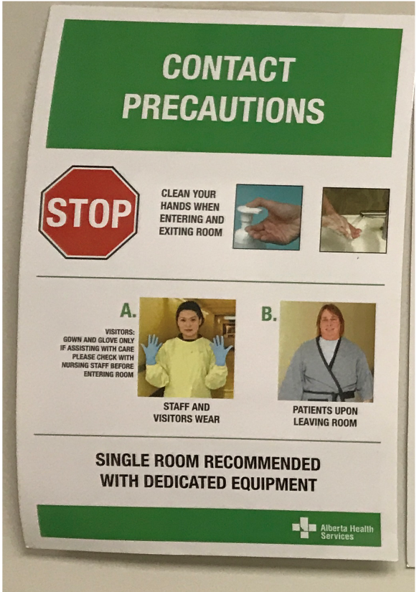
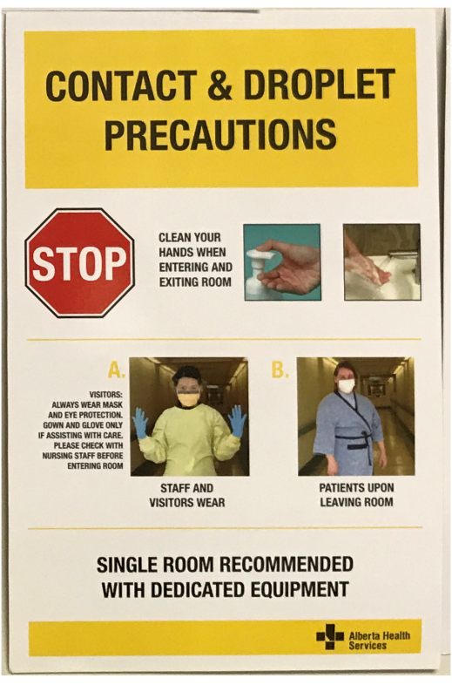
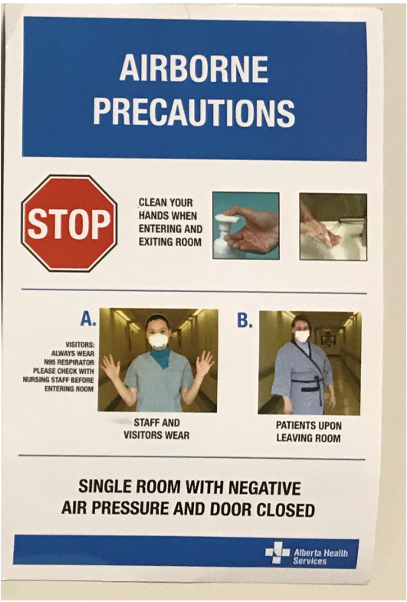
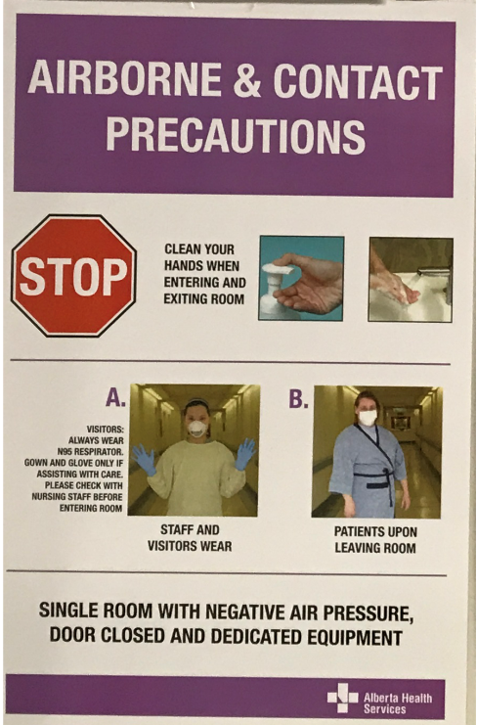
Scene 2 Posters Introduction
You take a closer look at the posters in front of you. There are two on top labelled “Donning” and “Doffing”. The posters below are types of precautions posters, including Contact, Airborne & Contact, Contact & Droplet, and Airborne.
All of them are wearing different PPE, so which poster do you follow?

Slide 67
Scene 2 Posters Clickable
Back to Door

Slide 68
DONNING poster intro PRE COMPUTER
This poster tells you how to put on or DON PPE. The poster says to don PPE in this order:
1: Clean hands
2: Don Gown (IF NEEDED)
3a: Don Procedural/Surgical Mask (IF NEEDED)
3b: Don N95 Respirator (If NEEDED)
4: Don Eye protection or Face shield (IF NEEDED)
5: Don Gloves (IF NEEDED)
The poster also describes how to put on each item properly.

Slide 69
DONNING poster outro
Back to Posters

Slide 70
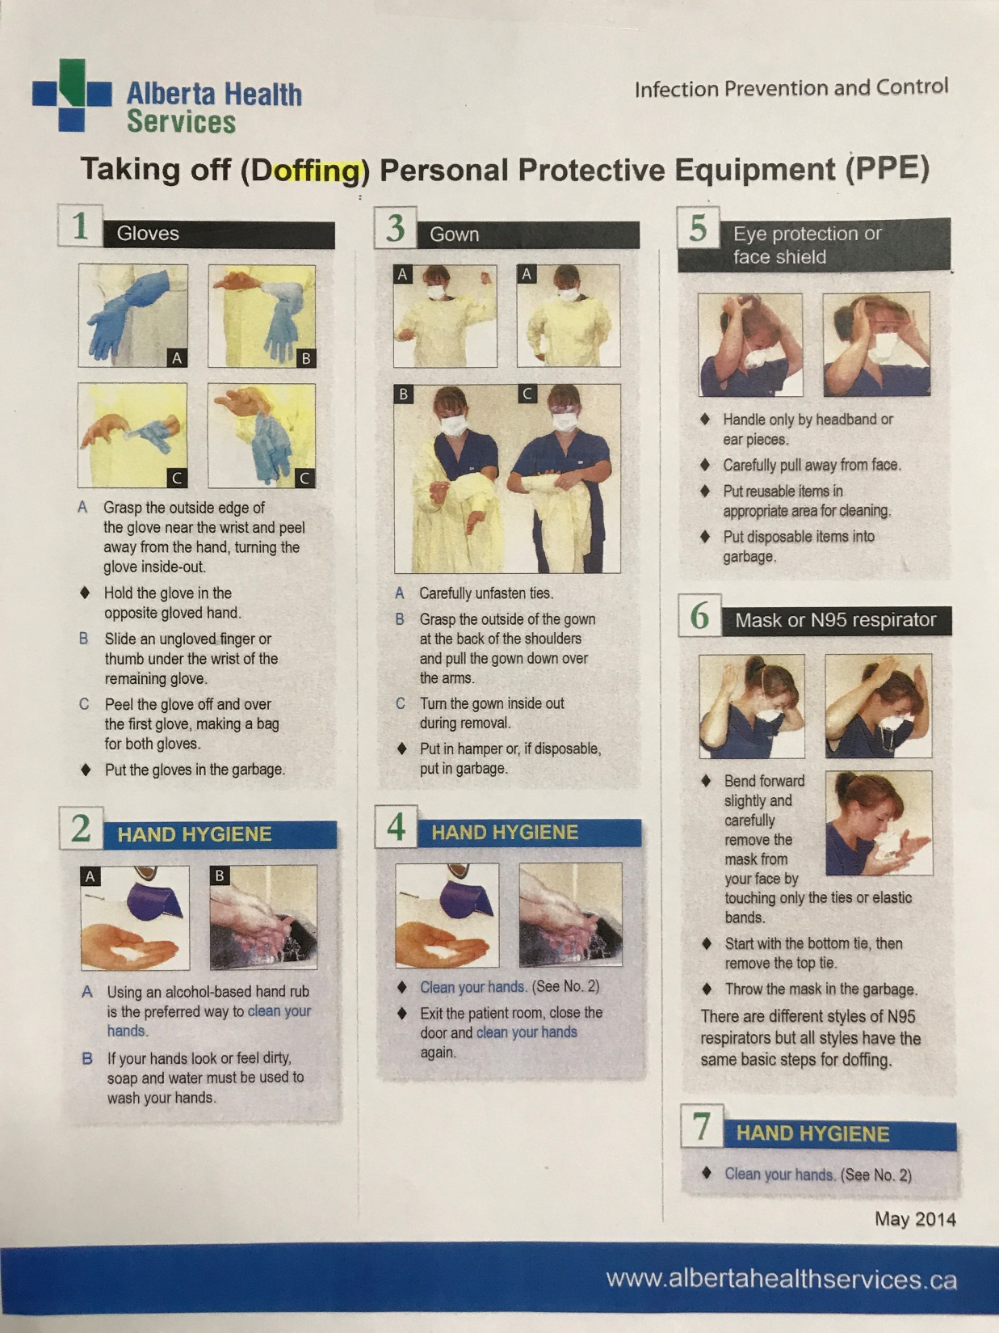
DOFFING poster intro PRE COMPUTER
This poster tells you how to DOFF (Take off) your PPE. You aren’t wearing any PPE right now so this probably isn’t too useful yet.

Slide 71
DOFFING poster outro
Back to Posters

Slide 72
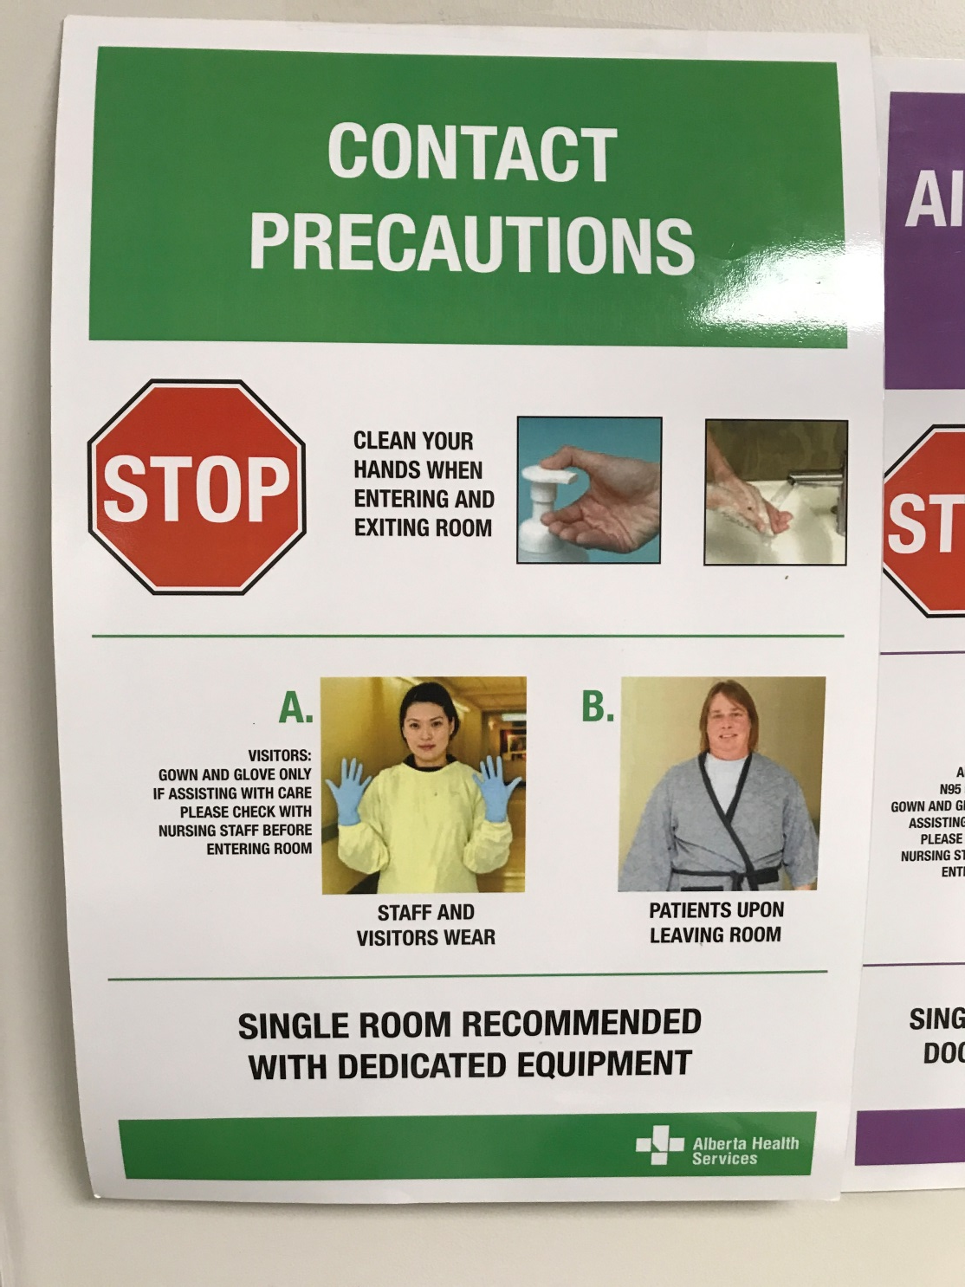
Contact poster intro PRE COMPUTER
You take a look at the first poster “Contact Precautions” in the photo, the visitor is wearing a yellow gown, and gloves. It also says to clean your hands first.

Slide 73
Contact poster outro
Back to Posters

Slide 74
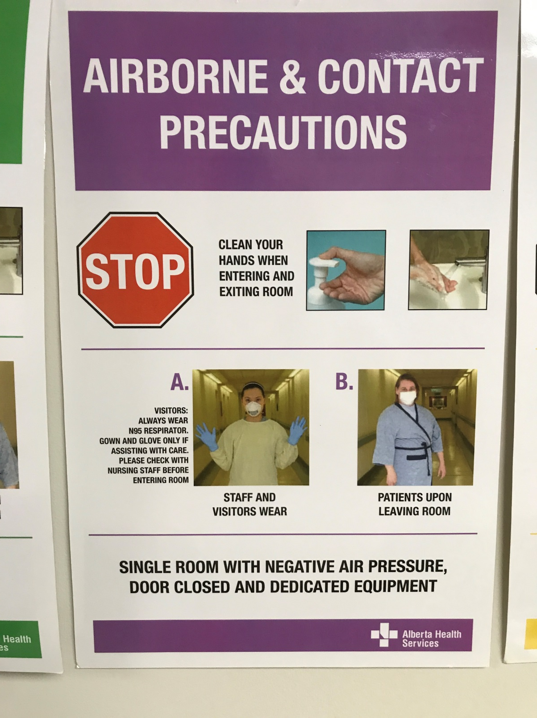
Aircontact poster intro PRE COMPUTER
You take a look at the second poster “Airborne & Contact Precautions” in the photo, the visitor is wearing a yellow gown, and gloves and an N95 respirator. This one also says to clean your hands first.

Slide 75
AirContact poster outro
Back to Posters

Slide 76
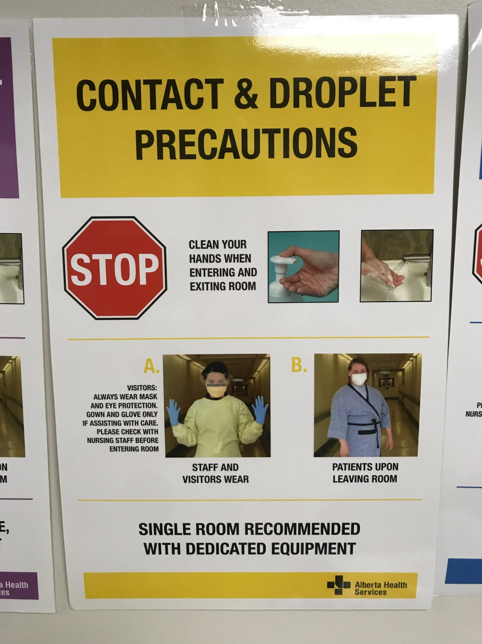
Droplet poster intro PRE COMPUTER
You take a look at the third poster “Contact & Droplet Precautions” in the photo, the visitor is wearing a yellow gown, and gloves and a mask and eye protection. But don’t forget to clean your hands first!

Slide 77
Droplet poster outro
Back to Posters

Slide 78
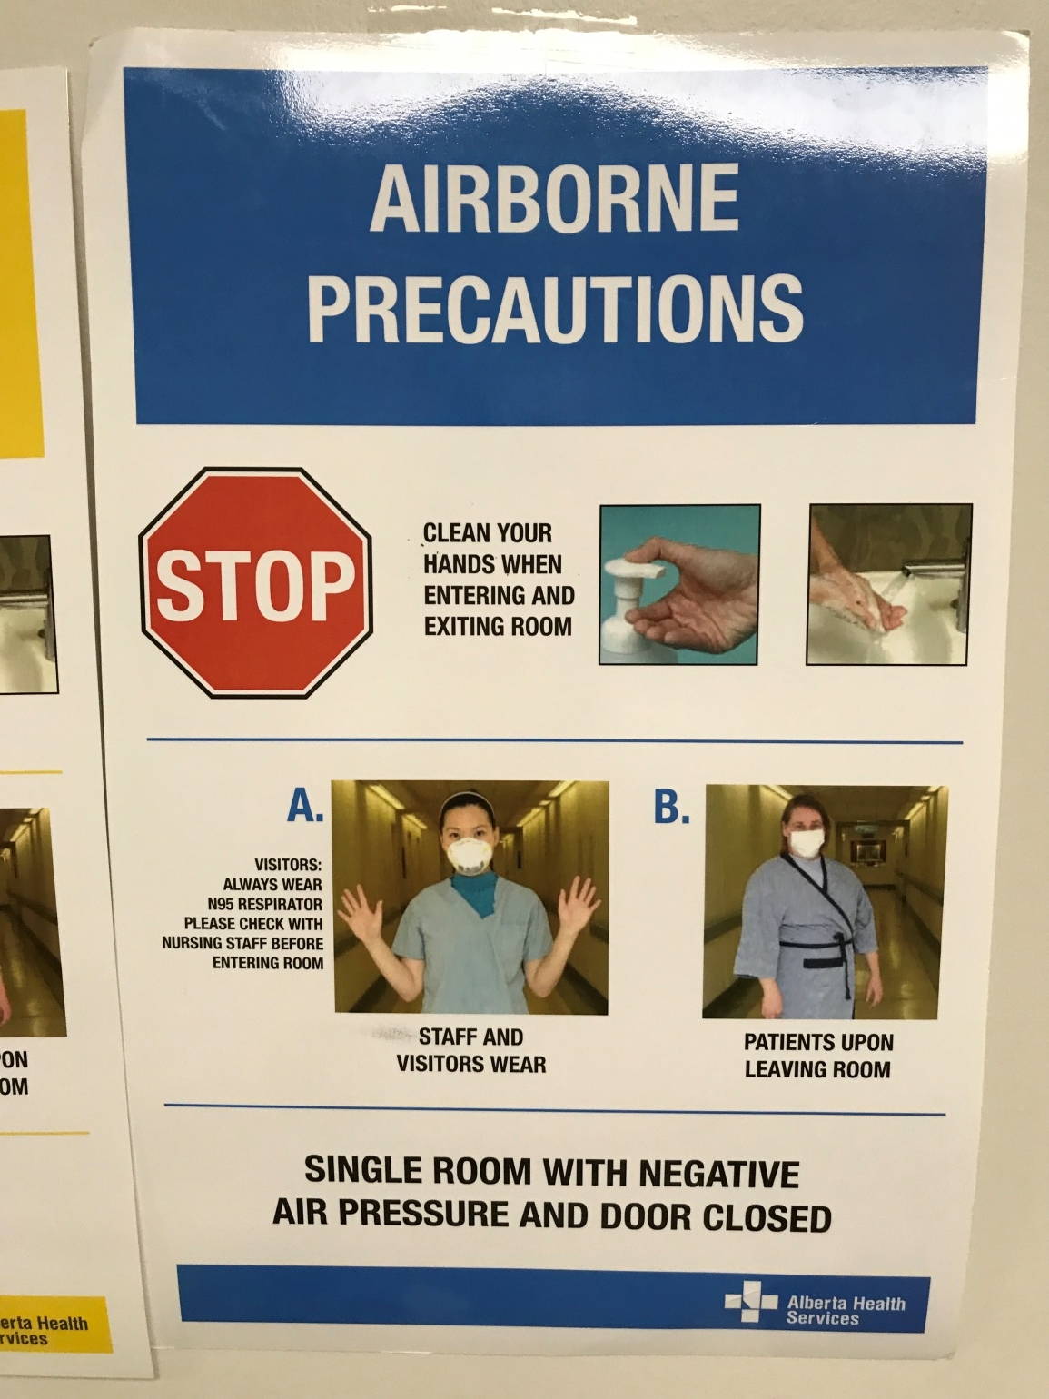
Airborn poster intro PRE COMPUTER
You take a look at the fourth poster “Airborne Precautions” in the photo, the visitor is wearing an N95 respirator only. And you guessed it, clean your hands FIRST.

Slide 79
Airborn poster outro
Back to Posters

Slide 80
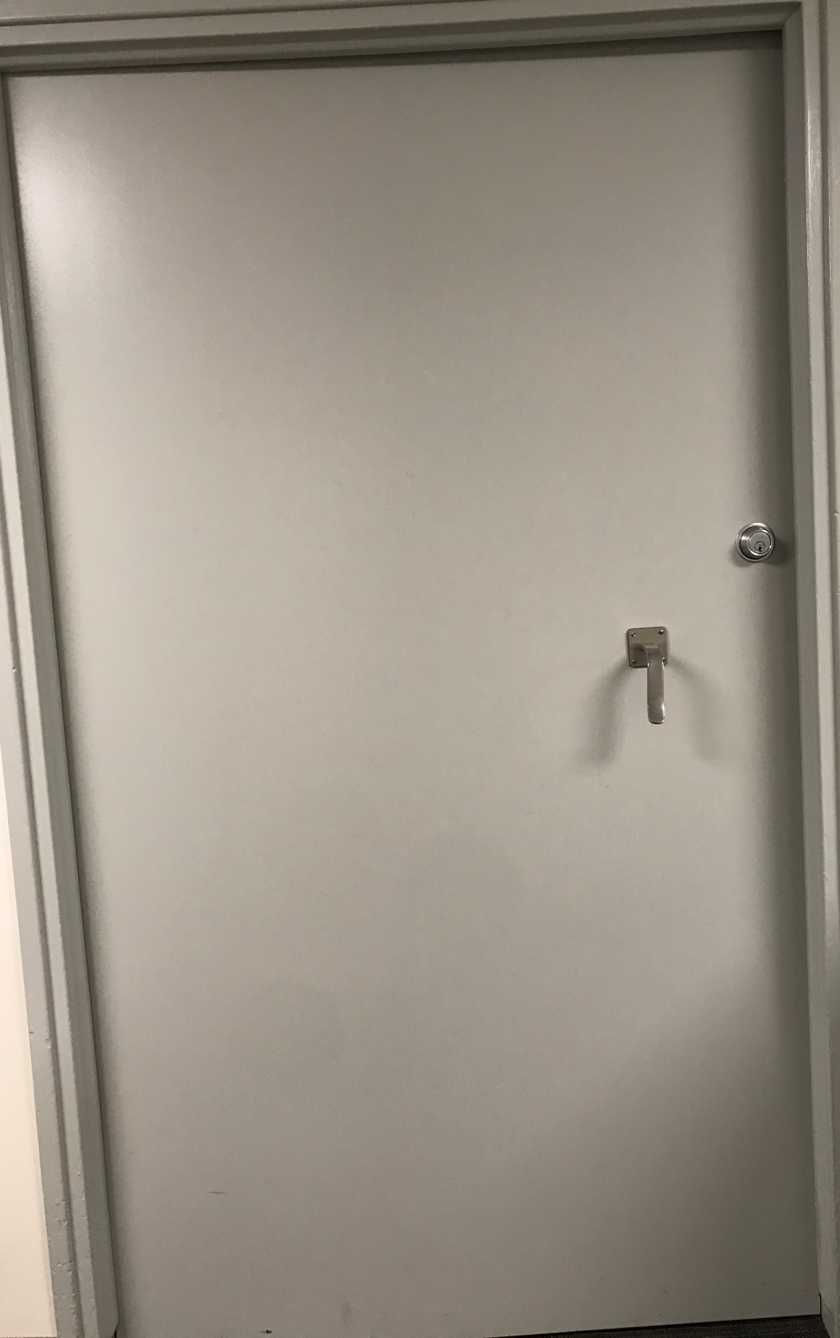
Scene 2 Door text
You take a look at the door, it looks pretty sturdy, you don’t think you can break it down, you give it a kick anyways. You are rewarded with a sore toe, and the camera speaker turning on again…
Go to Desk

Slide 81
Scene 2 Door text2
“Incorrect PPE detected. Please use proper donning procedures to don appropriate PPE for current lab setting. See IPC resource manual “Lignum Virum”for more information.”
Go to Desk

Slide 82
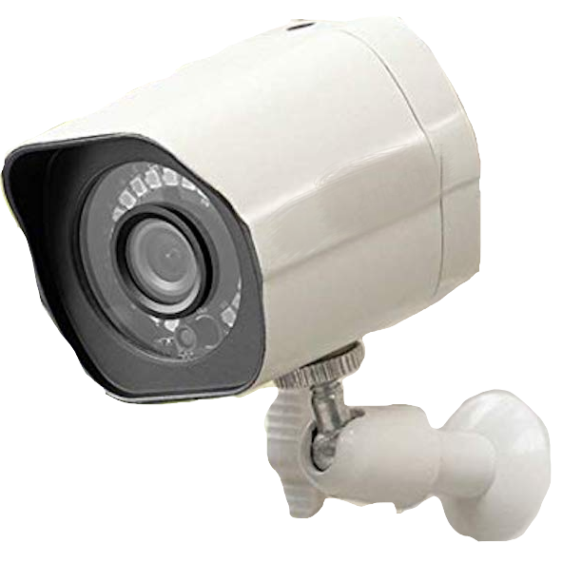
Scene 2 Camera select text
You stand on your tippy-toes to get a closer look at the camera, the light is on inside and it looks very fancy. The camera seems to be overlooking the entire room, and a wire connects it to the door. If you put on the correct PPE with proper donning procedure maybe the camera will let you in?
Go to Desk

Slide 83
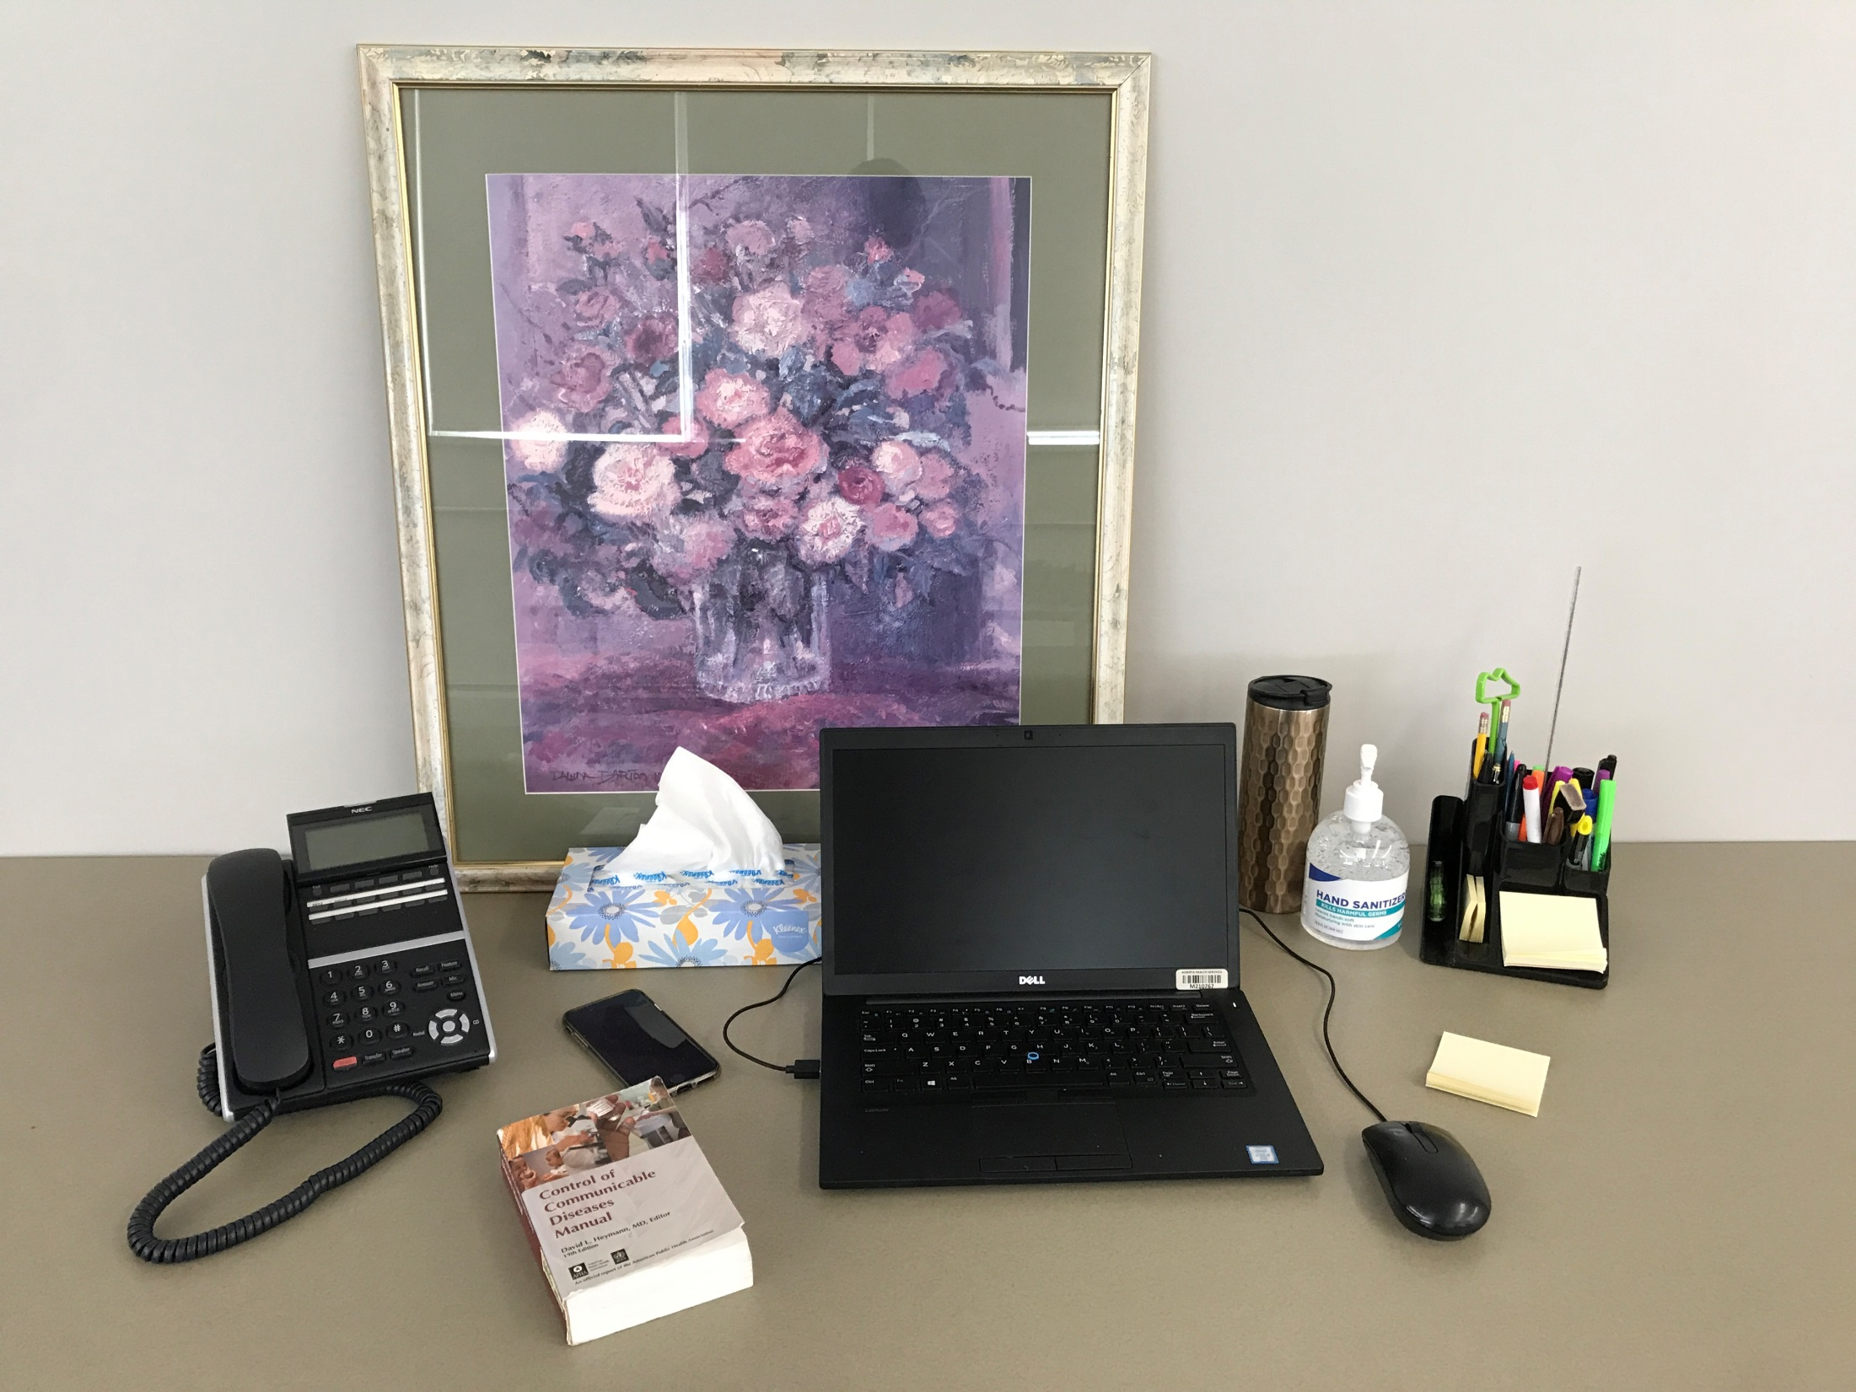
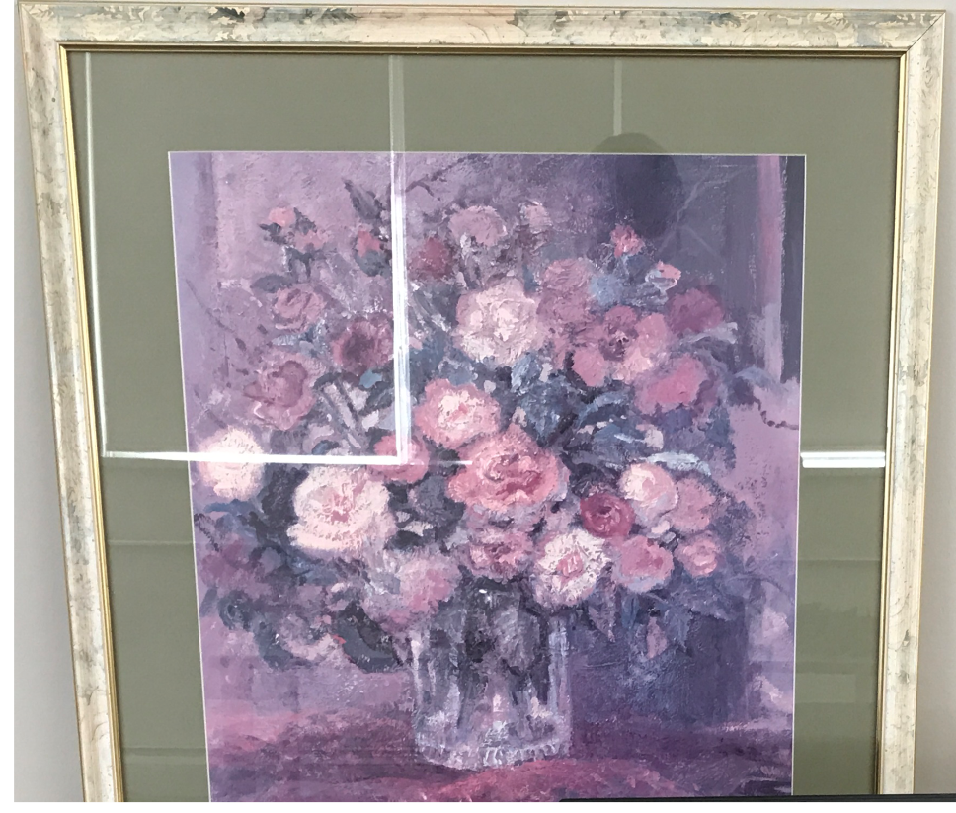
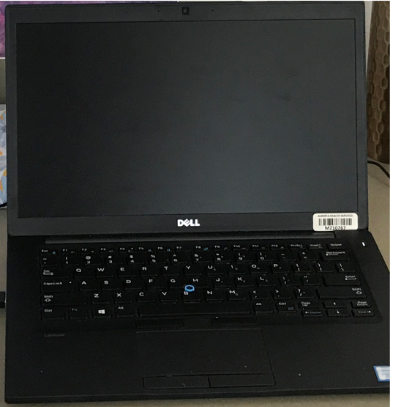
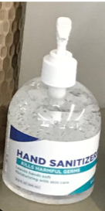
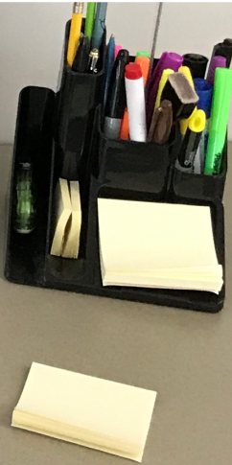
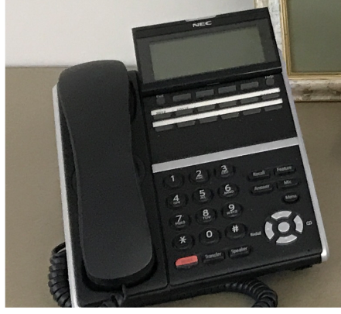
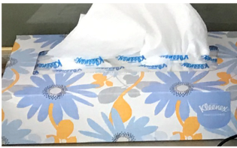
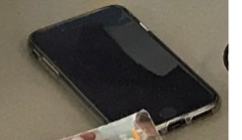
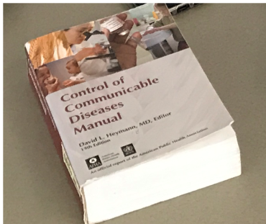
Scene 2 Desk Intro
On the left side of the room is a small desk with a laptop and some other objects on it. You’re looking for some information on what PPE to wear for the camera, maybe you can find something here?

Slide 84
Scene 2 Desk Clickable
Go to Door

Slide 85
Scene 2 Desk Phone Text
You take a closer look at the desk phone, there isn’t any numbers preset into it and it looks like it can only do internal calls. You press some buttons and hope you get lucky……………………………………………
No answer, oh well.

Slide 86
Scene 2 Desk Cell Phone Text
There’s a cell phone here, you try to turn it on but the battery is dead. Doesn’t look like it will be too helpful

Slide 87
Scene 2 Desk Painting Text
There’s a painting with a bunch of flowers pouring out of a glass vase. You don’t notice anything strange about the photo, though it seems a bit more ominous given that people are turning into plants!

Slide 88
Scene 2 Desk Book Text
“Control of Communicable Diseases Manual” This sounds perfect, maybe there is something in here about the tree virus? You search the index but can’t find anything that will help. In fact you can’t find anything on the tree virus at all! The book must have been published before the tree virus was discovered.

Slide 89
Scene 2 hand sanitizer text
There is a small bottle of alcohol based hand sanitizer on the desk here. You press the pump down –Squirt- and clean your hands. It smells like….. ethanol, you suppose the smell makes sense and are unsure what you were expecting. At least your hands are clean now though!

Slide 90
Scene 2 Desk Kleenex text
A regular old tissue box, nothing interesting here.

Slide 91
Scene 2 Desk STICKYNOTE TEXT GAIN PASSWORD
It’s a sticky note looks like there’s a reminder to pick up cat food and text Mom… Wait, is there something else here?

Slide 92
Scene 2 Desk Computer Text (PRE PASSWORD)
Back to desk
Try guessing password
You wiggle the mouse to bring the computer out of sleep mode. The computer flashes a login screen and requests a password. You remember that some people are guilty of the horrible information technology crime of having their password written down. Maybe if you look around you will find the password nearby?

Slide 93
Password list 1
1234
12345
Catsarecute5
Supercalifragilistic
hockeyfan9
Password2
puppydog9
comedyfan8
guest
password1234
Guest
cats64
Test
password
Flowers
123456789
Pass-word
jester54
2314
Password1234
Pinkflowers
More Passwords
Give Up
What password should you try? (If you don’t see the one you want, select more passwords to see a different list or select give up to look around the desk more)

Slide 94
Password list 2
6789
56789
oiasyuet863
Guest675
iceCream12
isugfsgxb98
Labpassword
zasjdfndslfjb6
Elephant5
monkey6
djuskyf43
Dustyroad90
Cricket45
crazycactus7
giraffe65
yyyyyyy23
PasswordforLabcomputer
pleasework1234
Lionmane72
Hibiscus6
gustofwind9
More Passwords
Give Up
What password should you try? (If you don’t see the one you want, select more passwords to see a different list or select give up to look around the desk more)

Slide 95
Password list 3
Guest123456
qwertyui123456
passsssssworrdddd
guest6754
bleargh23
musicmaker5
Tswiftfan87
asdfghjkl
dreamer61
HandHygiene3456
guest987654
leftleftrightright
bEngalcat61
85kky7
Cricket75
Guest5678432
adshudsf6543s
piano51
ladybuG73
FlowerPot71
zxcvbnm678
More Passwords
Give Up
What password should you try? (If you don’t see the one you want, select more passwords to see a different list or select give up to look around the desk more)

Slide 96
Computer Password FAIL
You enter the password into the computer and press enter. PASSWORD FAILED.
Hmm maybe instead of guessing I should take a look around the desk? Maybe someone left a hint.

Slide 97
Computer login success
The password Cricket75 works! If this isn’t a reminder to not write down your password I don’t know what is! Though the computer’s owner’s mistake was very helpful for you here!

Slide 98
Computer List of T Virus
The computer logs in and is already opened up into the “IPC RESOURCE MANUAL” on the IPC webpage. This is where you can find the information you need. Now, what was this virus called again?

Slide 99
Computer List of T Virus Selectable

Slide 100
Computer List of T Virus INCORRECT SELECTION
You click a link but it brings you to a disease that you don’t recognize, that wasn’t the one. You navigate back to the “T” section and take another look for the correct virus.

Slide 101
Tvirus Focus Text
“Tree Disease” or Lignum Virum. “Development of bark and leaves throughout entire body, limb stiffness” this is definitely the one you were looking for (Although it kind of understates the severity in your opinion)

Slide 102
T Virus Highlight text
You are looking for information on what PPE you need to wear so that the camera will let you through the door into the lab…
It doesn’t say anything about what to wear, but it does say “Contact Precautions”. You remember there was a sign above the PPE cart that described what to wear for Contact Precautions. That should work!

Slide 103
List of T Virus Clickable
Leave Computer
You are looking for information on what PPE you need to wear so that the camera will let you through the door into the lab…
It doesn’t say anything about what to wear, but it does say “Contact Precautions”. You remember there was a sign above the PPE cart that described what to wear for Contact Precautions. That should work!

Slide 104
r List of T Virus Secondary Contact Precautions highlight
This page says the virus is contact precautions. I should go check out the sign above the PPE cart, and then I can put on the PPE that the sign tells me to!

Slide 105
AFTER COMPUTER Scene 2 Greater Door Clickable
Go to Desk

Slide 106
AFTER COMPUTER Scene 2 Posters Introduction
You take a closer look at the posters in front of you. There are two on top labelled “Donning” and “Doffing”. The posters below are types of precautions posters, including Contact, Airborne & Contact, Contact & Droplet, and Airborne.
All of them are wearing different PPE, so which poster do I follow?

Slide 107
AFTER COMPUTER Scene 2 Posters Clickable
Back to Door

Slide 108
DONNING poster intro POST COMPUTER
This poster tells you how to put on or DON PPE. The poster says to don PPE in this order:
1: Clean Hands
2: Don Gown (IF NEEDED)
3a: Don Procedural/Surgical Mask (IF NEEDED)
3b: Don N95 Respirator (If NEEDED)
4: Don Eye protection or Face shield (IF NEEDED)
5: Don Gloves (IF NEEDED)
The poster also describes how to put on each item properly.

Slide 109
DONNING poster intro POST COMPUTER
The Contact Precautions poster tells you which of all those PPE you will need, so lets put the information together!

Slide 110
DONNING poster outro
Back to Posters

Slide 111
DOFFING poster intro POST COMPUTER
This poster tells you how to DOFF (Take off) your PPE. You aren’t wearing any PPE right now so this probably isn’t too useful yet.

Slide 112
DOFFING poster outro
Back to Posters

Slide 113
AFTER Contact poster intro OFFICIAL
You take a look at the first poster “Contact Precautions” in the photo, the visitor is wearing a yellow gown, and gloves. It also says to clean your hands first. This is the precautions the computer said to use for the Tree Disease! So we will need to clean our hands then don a Yellow Gown, and Gloves. Remember you have to don in the correct order as well!

Slide 114
AFTER Contact poster outro
Back to Posters

Slide 115
AFTER Air contact poster intro POST
You take a look at the second poster “Airborne & Contact Precautions” This isn’t the precautions the computer told you to use.

Slide 116
AFTER Air Contact poster outro
Back to Posters

Slide 117
AFTER Droplet poster intro PPOST
You take a look at the third poster “Contact & Droplet Precautions” This isn’t the precautions the computer told you to use.

Slide 118
AFTER Droplet poster outro
Back to Posters

Slide 119
AFTER Airborne poster intro POST
You take a look at the fourth poster “Airborne Precautions” This isn’t the precautions the computer told you to use.

Slide 120
AFTER Airborne poster outro
Back to Posters

Slide 121
AFTER Scene 2 Door text
You take a look at the door, it looks pretty sturdy, you don’t think you can break it down, you give it a kick anyways. You are rewarded with a sore toe, and the camera speaker turning on again…
Go to Desk

Slide 122
AFTER Scene 2 Door text2
“Incorrect PPE detected. Please use proper donning procedures to don appropriate PPE for current lab setting. See IPC resource manual “Lignum Virum”for more information.”
Go to Desk

Slide 123
AFTER Scene 2 Camera select text
You stand on your tip-toes to get a closer look at the camera, the light is on inside and it looks very fancy. The camera seems to be overlooking the entire room, and a wire connects it to the door. If you put on the correct PPE with proper donning procedure maybe the camera will let you in?
Go to Desk

Slide 124
AFTER Scene 2 Desk Intro
You have found from the IPC resource manual that the Tree Disease requires CONTACT PRECAUTIONS you don’t think you will find anything else useful here.

Slide 125
AFTER Scene 2 Desk Clickable
Go to Door

Slide 126
PPE CART PUZZLE Intro
You take a closer look at the cart with PPE. Are you ready to don your PPE? Judging by what the camera said earlier you need to only put on the correct items, and do so in the correct order.

Slide 127
PPE CART PUZZLE Intro
Leave PPE Cart
Click to Begin Donning PPE

Slide 128
PPE CART PUZZLE Begin
Start Over
Leave PPE Cart
Click on the box for the PPE or object you wish to use. When you have everything you need, select try the door

Slide 129
PPE CART PUZZLE Gloves incorrect path
Start Over
Leave PPE Cart
Try the door
You grab a pair of gloves from the box and put them on. What next?

Slide 130
PPE CART PUZZLE Hand san incorrect path
Start Over
Leave PPE Cart
Try the door
You pump hand sanitizer into your hands and rub it into your hands until it is gone. Your hands are now clean!

Slide 131
PPE CART PUZZLE Gown incorrect path
Start Over
Leave PPE Cart
Try the door
You pick up a yellow gown and put your arms through the sleeves, you reach over your shoulder and waist and tie yourself up. What next?

Slide 132
PPE CART PUZZLE Face Shield incorrect path
Start Over
Leave PPE Cart
Try the door
You pick up a face shield and put it on, do I really need one of these? What next?

Slide 133
PPE CART PUZZLE Face mask incorrect path
Start Over
Leave PPE Cart
Try the door
You pull a face mask out of the box and put it over your face pinching the top against your nose. What next?

Slide 134
PPE CART PUZZLE Eye protection incorrect path
Start Over
Leave PPE Cart
Try the door
You put on the eye glasses. What next?

Slide 135
PPE CART PUZZLE First step correct
Start Over
Leave PPE Cart
Try the door
You pump the hand sanitizer and clean your hands. What next?

Slide 136
PPE CART PUZZLE Second step correct
Start Over
Leave PPE Cart
Try the door
You pick up a yellow gown and put your arms through the sleeves, you reach over your shoulder and waist and tie yourself up. What next?

Slide 137
PPE CART PUZZLE Third step correct
Start Over
Leave PPE Cart
Try the door
You grab a pair of gloves from the box and put them on. Is that it?

Slide 138
PPE CART PUZZLE Door try Fail HINT
Try Again
Darn, looks like you’re wearing either the wrong PPE or didn’t follow the correct donning procedure. What did I do wrong?
Hint: Remember to clean your hands before donning PPE and only put on the PPE you need for Contact Precautions

Slide 139
PPE CART PUZZLE Door try Fail
You stand in front of the door and try the handle, you hear a light “BEEP” and the camera says out loud:

Slide 140
PPE CART PUZZLE Door try Fail 2
“Incorrect PPE or donning procedure detected. Please try again choosing the proper PPE and donning procedure”

Slide 141
PPE CART PUZZLE Door try Fail 3
Try Again
Darn, looks like you’re wearing either the wrong PPE or didn’t follow the correct donning procedure. What did I do wrong?
Hint:

Slide 142
PPE CART PUZZLE Door try Success
You stand in front of the door and try the handle, you hear a light “BEEP” and the camera says out loud:

Slide 143
PPE CART PUZZLE Door try Success 2
“Correct PPE and donning procedure detected. The door is now unlocked for 15 seconds”

Slide 144
PPE CART PUZZLE Door try Success 2
Success!!!! You quickly push the door open and hurry inside

Slide 145
SCENE 3 INTRO
You enter the laboratory. Finally! You are greeted by a creepy sight. You see two individuals stiff as a tree. Their nametags say Flora, and Fauna, your friend who texted you! Also in the back of the room is A FRIDGE!

Slide 146
SCENE 3 INTRO2
Fauna said the creams were in the fridge! You run over to the fridge and try the door. It’s locked. Why is everything locked around here! You see another keypad on the side of the fridge. This one has the digits 0-9 with letters, and looks like it requires a 3 digit code to unlock the fridge.

Slide 147
SCENE 3 INTRO3
You look back to the scene in front of you. You feel bad for the two people, who are now trees, and know you need to be the one to help them! Knowing they need your help fills you with determination!

Slide 148
SCENE 3 Clickable

Slide 149
Table Intro (Pre slide)
You take a closer look at the table on left. There are some objects here including a microscope that was being used by Fauna.

Slide 150
Table Clickable (Pre slide)
Go Back

Slide 151
Table Hand san dialogue
There’s some hand sanitizer here, but you have gloves on so you don’t use it. No sanitizer on gloves!

Slide 152
Table Wipes dialogue
“AHS Approved Cleaning Wipes”. They say they are alcohol based and can be used to clean the microscope. So you can use these to clean something if you need to!

Slide 153
Table Microscope dialogue
There’s a microscope here. There is nothing on the viewing platform except for a blank slide.

Slide 154
Table Vials dialogue
You see some vials with coloured liquids inside them. They have labels on them, but you aren’t sure they will be useful.

Slide 155
Fauna Dialogue
There’s a person here that has been turned into a tree… It’s your friend Fauna! They were using the microscope. The leaves sure grew in fast. I better be careful not to touch Fauna’s skin or leaves with my skin if I don’t want to be a tree!

Slide 156
Flora Zoom intro
You take a closer look at the person standing to the side. It says their name is Flora. Don’t worry Flora I’ll help you! Maybe not until I get into that fridge though… Is there anything here on Flora?

Slide 157
Flora Zoom Clickable
Go Back

Slide 158
Flora Nametag dialogue
Flora, I’ve seen that name written somewhere around here before… Other than the name tag I mean

Slide 159
Flora IS A TREE dialogue
You move your hand close to the leaves to touch one. But stop yourself at the last moment. You need to be careful if you don’t want to catch the tree virus, you know it spreads by contact. You have gloves on but what if you accidentally touch your face with those gloves! Better be safe than sorry here.

Slide 160
Flora slide found dialogue
Underneath Flora’s name tag is a small pocket in the lab coat. You reach inside the lab coat and find…. A microscope slide?

Slide 161
Flora slidefounddialogue 2
You take the microscope slide out and see that it says “Fridge Passcode” however there is not a passcode visible that you can see. You take the microscope slide over to the bench on the left.

Slide 162
Fridge intro
You move over to the fridge and try to open the door. Still locked. You look at the side of the fridge door and see a small keypad. The keypad has numbers from 0-9. Guessing would be pointless so you ignore the keypad for now to try to look for the code. You notice some sticky notes on the front of the fridge and look more closely.

Slide 163
Fridge Clickable
Hint
Go Back

Slide 164
Fridge Doesn’t seem important dialogue
There are some sticky notes on the left here, “Willow Back Monday” “Microscope #10 not working” “Misty owes $5.00 for Jess’ Mat gift”
Doesn’t look like any of these four are useful.

Slide 165
Fridge Time sheet dialogue
A sticky note. It says “Don’t forget to fill out timesheets!”

Slide 166
Fridge Jack late dialogue
A sticky note. It says “Jack starts late Friday”. I don’t think that’s helpful to me/

Slide 167
Fridge Quiz date dialogue
A sticky note. It says “ Check for Quiz date with Merryweather”

Slide 168
Fridge FLORA HAS THE CODE DIALOGUE
Hint
This sticky note says “Flora has the code” Wait! Flora is one of the scientists in this lab! I should take a closer look at Flora, maybe she has the code on her person?

Slide 169
Fridge HINT
The note seems to indicate that a person named “Flora” has the code. Find the person named Flora, and check to see if they have a hidden pocket!

Slide 170
Table Intro (POST SLIDE)
You move over to the table with the microscope. You should take a closer look at the microscope slide you found in Flora’s pocket.

Slide 171
Table Clickable (postslide)

Slide 172
Table Hand san dialogue Postslide
There’s some hand sanitizer here, it can be used to clean my hands, but I don’t think I should use it to clean the microscope, I’m sure there is something else here I can clean the microscope with.

Slide 173
Table Vials dialogue
You see some vials with coloured liquids inside them. They have labels on them, but you aren’t sure they will be useful.

Slide 174
Tabl MicroscopedialoguePREWIPED
You consider using the microscope but remember that you had moved the microscope away from Fauna. If she was working on this thing, it might be contaminated. You should probably clean it first.

Slide 175
Table Wipes dialogue
You grab some nearby 95% alcohol cleaner, and microscope lens paper to wipe down the equipment. You use the proper cleaning methods to do so, including changing your gloves and cleaning your hands with the nearby hand sanitizer.

Slide 176
Table Wipes dialogue2
After cleaning the microscope you put the microscope slide you found under the microscope and take a look.

Slide 177
Table Microscope SLIDE ZOOM INTRO
After putting the microscope slide in place, You put your eye against the eye piece. You don’t see anything immediately but manipulate the focus to bring something into view.

Slide 178
Table Microscope SLIDE Puzzle Dialogue1
You set the magnification to 200x and manage to bring something into focus. Weird! Looking at the slide without the microscope it looked like it had nothing on it!

Slide 179
Table Microscope SLIDE Puzzle Dialogue 2
There should be something here. If this is the passcode for the fridge there should be a 3 character code somewhere in frame. Once you have found the code in this picture, press the blue button to go try the code on the fridge keypad

Slide 180
Table Microscope SLIDE Puzzle MOVABLE
Go to Fridge Keypad
Hint

Slide 181
Table Microscope SLIDE Puzzle Hint
You are looking for a 3 character code, it could be letters or numbers. If you look closely, can you see the letter “A” shaped out of the purple bacteria? Now find 2 more!

Slide 182
Fridge Keypad intro
You move to the fridge to enter a code. The code is three digits long.
START CODE
Look at the Microscope Slide Again

Slide 183
Fridge Keypad Start
Enter the FIRST number now.

Slide 184
Fridge Keypad Step 1 correct
Enter the second digit now.

Slide 185
Fridge Keypad Step 2 correct
Enter the third digit now.

Slide 186
Fridge Keypad Step 3 correct
You press the third and last digit. You here a CLICK, as the latch locking the fridge releases! The fridge door is unlocked!
Great job!

Slide 187
Fridge Keypad Step 1 WRONG
Enter the second digit now.

Slide 188
Fridge Keypad Step 2 WRONG
Enter the third digit now.

Slide 189
Fridge Keypad Step 3 WRONG
You press the third and last digit. The keypad gives a BZZT.
Looks like the code entered was incorrect. Maybe you should look at the microscope slide again?

Slide 190
Fridge Success celebration
The code worked! You open the fridge and can see the cream cure in a container in the fridge. You carefully grab the container and close the fridge.

Slide 191
Cream: How to use
You read the label. “Apply a small droplet to an affected area, recovery should begin in 1 hour” you close the fridge and return to the lab.
Is that a fingerprint slightly visible on the lid?

Slide 192
Cream exited fridge
Alright I’ve got the cream! Now I just need to get the cream out of the building without turning into a tree myself. I better not slip up now!

Slide 193
Cream Exit fridge clickable
Leave Lab

Slide 194
Cream lab click dialogue
You glance around the lab. But you have the cream already, there is nothing on the lab counters or fridge for you except to leave.

Slide 195
Apply cream dialogue
You carefully open the cream and put some on a small tongue depressor you find nearby. You spread the cream on the hands of each Fauna and Flora. There! That should get them on the road to recovery! You still need to leave the lab though so the cream can be brought to the other patients!

Slide 196
Cream applied clickable
Leave Lab

Slide 197
Cream APPLIED lab click dialogue
You glance around the lab. But you have the cream already, and applied some to the people here, there is nothing else here for you can do here except leave.

Slide 198
SCENE 4 FINAL PUZZLE EXIT DOFFING
You head towards the exit. There is a door with a camera identical to the one you needed to pass into the lab. You try the door, but it’s locked and get the same song and dance from this camera:

Slide 199
SCENE 4 CAMERA DIALOGUE
“Lab PPE is not to be worn outside of laboratory area. Please follow proper doffing procedure and remove all PPE before exiting laboratory area.”

Slide 200
SCENE 4 Camera Dialogue 2
Isn’t having the exit locked a fire hazard? Alright fine then, this is the last hurdle. Let’s check the doffing poster to make sure you do this right!

Slide 201
SCENE 4 Clickable
Look at Doffing Poster
Begin Doffing

Slide 202
SCENE 4 Look at poster Dialogue
You take a look at a Doffing poster nearby. The doffing posters says to doff your gloves, and then your gown, performing hand hygiene after each step.

Slide 203
SCENE 4 Look at poster

Slide 204
SCENE 4 Wipe Creams dialogue
You notice some AHS approved wipes on the side by the exit. You think really hard about what has happened in the lab, and realize, what if the creams were contaminated here? You were careful about not having skin contact with anything, including the microscope, but what if the cream container was also contaminated? You grab a wipe and wipe down the container. There that should make sure I’m safe!

Slide 205
SCENE 4 Doffing Begin
Perform Hand Hygiene
Doff Gloves
Doff Gown
Try Exit Door
Select the action you wish to perform.

Slide 206
Doffing Correct Gloves
Start over
Perform Hand Hygiene
Doff Gown
Try Exit Door
You doff your gloves.

Slide 207
Doffing Correct gloves-HH
Start over
Perform Hand Hygiene
Doff Gown
Try Exit Door
You perform hand hygiene.

Slide 208
Doffing Correct gloves-HH-Gown
Start over
Perform Hand Hygiene
Try Exit Door
You doff your gown.

Slide 209
Doffing Correct gloves-HH-Gown-HH
Start over
Perform Hand Hygiene
Try Exit Door
You perform hand hygiene.

Slide 210
Doffing InCorrect HH
Start over
Perform Hand Hygiene
Doff Gloves
Doff Gown
Try Exit Door
You perform hand hygiene on your gloves.

Slide 211
Doffing InCorrect Gloves
Start over
Perform Hand Hygiene
Doff Gown
Try Exit Door
You doff your gloves.

Slide 212
Doffing InCorrect Gloves HH
Start over
Perform Hand Hygiene
Doff Gown
Try Exit Door
You perform hand hygiene.

Slide 213
Doffing InCorrect Gloves Gown
Start over
Perform Hand Hygiene
Try Exit Door
You doff your gown.

Slide 214
Doffing InCorrect Gloves Gown HH
Start over
Perform Hand Hygiene
Try Exit Door
You perform hand hygiene.

Slide 215
Doffing InCorrect HH GOWN
Start over
Perform Hand Hygiene
Doff Gloves
Try Exit Door
You doff your gown.

Slide 216
Doffing InCorrect GOWN HH
Start over
Perform Hand Hygiene
Doff Gloves
Try Exit Door
You perform hand hygiene.

Slide 217
Doffing InCorrect GOWN HH Gloves
Start over
Perform Hand Hygiene
Try Exit Door
You doff your gloves.

Slide 218
Doffing FAILED CAMERA1
You try the door. Unfortunately it is still locked. The camera speaker turns on and says

Slide 219
Doffing FAILED CAMERA2
“Incorrect doffing procedure detected. Please refer to doffing poster and doff PPE in correct order and with proper hand hygiene between each step.”

Slide 220
Doffing FAILED CAMERA3
Try Again
Shoot! I must have not followed the correct doffing procedure…

Slide 221
Hooray PARTIAL Success! 1
“Correct PPE and doffing procedure detected. The door is now unlocked for 15 seconds”

Slide 222
Hooray PARTIAL Success! 2
You’ve done it! You grab the creams with your hand and rush out the door, the creams can now be delivered to the hospital to treat those that have been infected!

Slide 223
Hooray PARTIAL Success! 2
You head out the front doors, the natural light blinding you, you rub your eyes with the hand holding the creams.

Slide 224
Hooray PARTIAL Success! 3
Suddenly you feel your limbs tighten up, your fingers no longer move as they should and stiffen sets into your joints! Oh no what is happening!

Slide 225
Hooray PARTIAL Success! 4
Your vision blurs, you reach for the cream but you drop it, and you are unable to bend over to pick it up! Did you get infected somewhere along the way?

Slide 226
Hooray PARTIAL Success! 5
Your lose colour in your vision, and you look down, you are surprised to see that leaves have sprouted out of your hands, you didn’t even feel them sprouting!

Slide 227
Hooray PARTIAL Success! 6
Your mind begins to swim, what did you do wrong? You think back to everything that has happened and have a sudden realization. You look down at the creams in front of you. The container must have been contaminated! It’s the only thing you would have touched from the lab since you cleaned your hands. It is probably how Fauna and Flora got infected as well!

Slide 228
Hooray PARTIAL Success! 7
When emergency services comes you hope they put on gloves, so they don’t get infected by the same bottle! You wish you would have wiped down the cream’s container before leaving……

Slide 229
Congratulations! You’ve completed the virtual escape room!!!
Would you like to go back to before you left the lab so you can wipe down the cream container and get the better ending?
Go Back to Doffing Sequence

Slide 230
SCENE 4 Clickable WIPED
Look at Doffing Poster
Begin Doffing

Slide 231
WIPEDLook at poster dialogue
You take a look at a Doffing poster nearby. The doffing posters says to doff your gloves, and then your gown, performing hand hygiene after each step.

Slide 232
WIPEDLook at poster

Slide 233
wipedSCENE 4 Doffing Begin
Perform Hand Hygiene
Doff Gloves
Doff Gown
Try Exit Door
Select the action you wish to perform.

Slide 234
wipedDoffing Correct Gloves
Start over
Perform Hand Hygiene
Doff Gown
Try Exit Door
You doff your gloves.

Slide 235
wipedDoffing Correct gloves-HH
Start over
Perform Hand Hygiene
Doff Gown
Try Exit Door
You perform hand hygiene.

Slide 236
wipedDoffing Correct gloves-HH-Gown
Start over
Perform Hand Hygiene
Try Exit Door
You doff your gown.

Slide 237
wipedDoffing Correct gloves-HH-Gown-HH
Start over
Perform Hand Hygiene
Try Exit Door
You perform hand hygiene.

Slide 238
wipedDoffing InCorrect HH
Start over
Perform Hand Hygiene
Doff Gloves
Doff Gown
Try Exit Door
You perform hand hygiene on your gloves.

Slide 239
wipedDoffing InCorrect Gloves
Start over
Perform Hand Hygiene
Doff Gown
Try Exit Door
You doff your gloves.

Slide 240
wipedDoffing InCorrect Gloves HH
Start over
Perform Hand Hygiene
Doff Gown
Try Exit Door
You perform hand hygiene.

Slide 241
wipedDoffing InCorrect Gloves Gown
Start over
Perform Hand Hygiene
Try Exit Door
You doff your gown.

Slide 242
wipedDoffing InCorrect Gloves Gown HH
Start over
Perform Hand Hygiene
Try Exit Door
You perform hand hygiene.

Slide 243
wipedDoffing InCorrect HH GOWN
Start over
Perform Hand Hygiene
Doff Gloves
Try Exit Door
You doff your gown.

Slide 244
wipedDoffing InCorrect GOWN HH
Start over
Perform Hand Hygiene
Doff Gloves
Try Exit Door
You perform hand hygiene.

Slide 245
wipedDoffing InCorrect GOWN HH Gloves
Start over
Perform Hand Hygiene
Try Exit Door
You doff your gloves.

Slide 246
WipedDoffing FAILED CAMERA1
You try the door. Unfortunately it is still locked. The camera speaker turns on and says

Slide 247
wipedDoffing FAILED CAMERA2
“Incorrect doffing procedure detected. Please refer to doffing poster and doff PPE in correct order and with proper hand hygiene between each step.”

Slide 248
wipedDoffing FAILED CAMERA3
Try Again
Shoot! I must have not followed the correct doffing procedure…

Slide 249
Success! 1
“Correct PPE and doffing procedure detected. The door is now unlocked for 15 seconds”

Slide 250
Success! 2
You hurry out the door and out the main exit outside, the cream in hand everyone that has been infected with the tree virus can be cured!

Slide 251
Success! 3
You deliver the cream to the local hospital who are able to use it to treat those patients infected with the virus!
Everyone thanks you repeatedly for ensuring the hard work of the team that created the cream didn’t spoil in the fridge!
You are the hero!

Slide 252
Congratulations
Congratulations! You have successfully saved the cream from expiring in the lab and saved everyone who was infected with the virus!

Slide 253
Thanks
Thanks for playing!
Feel free to share with your colleagues if you enjoyed the experience!
If you have any feedback you can contact: hand.hygiene@ahs.ca

